Slide 1
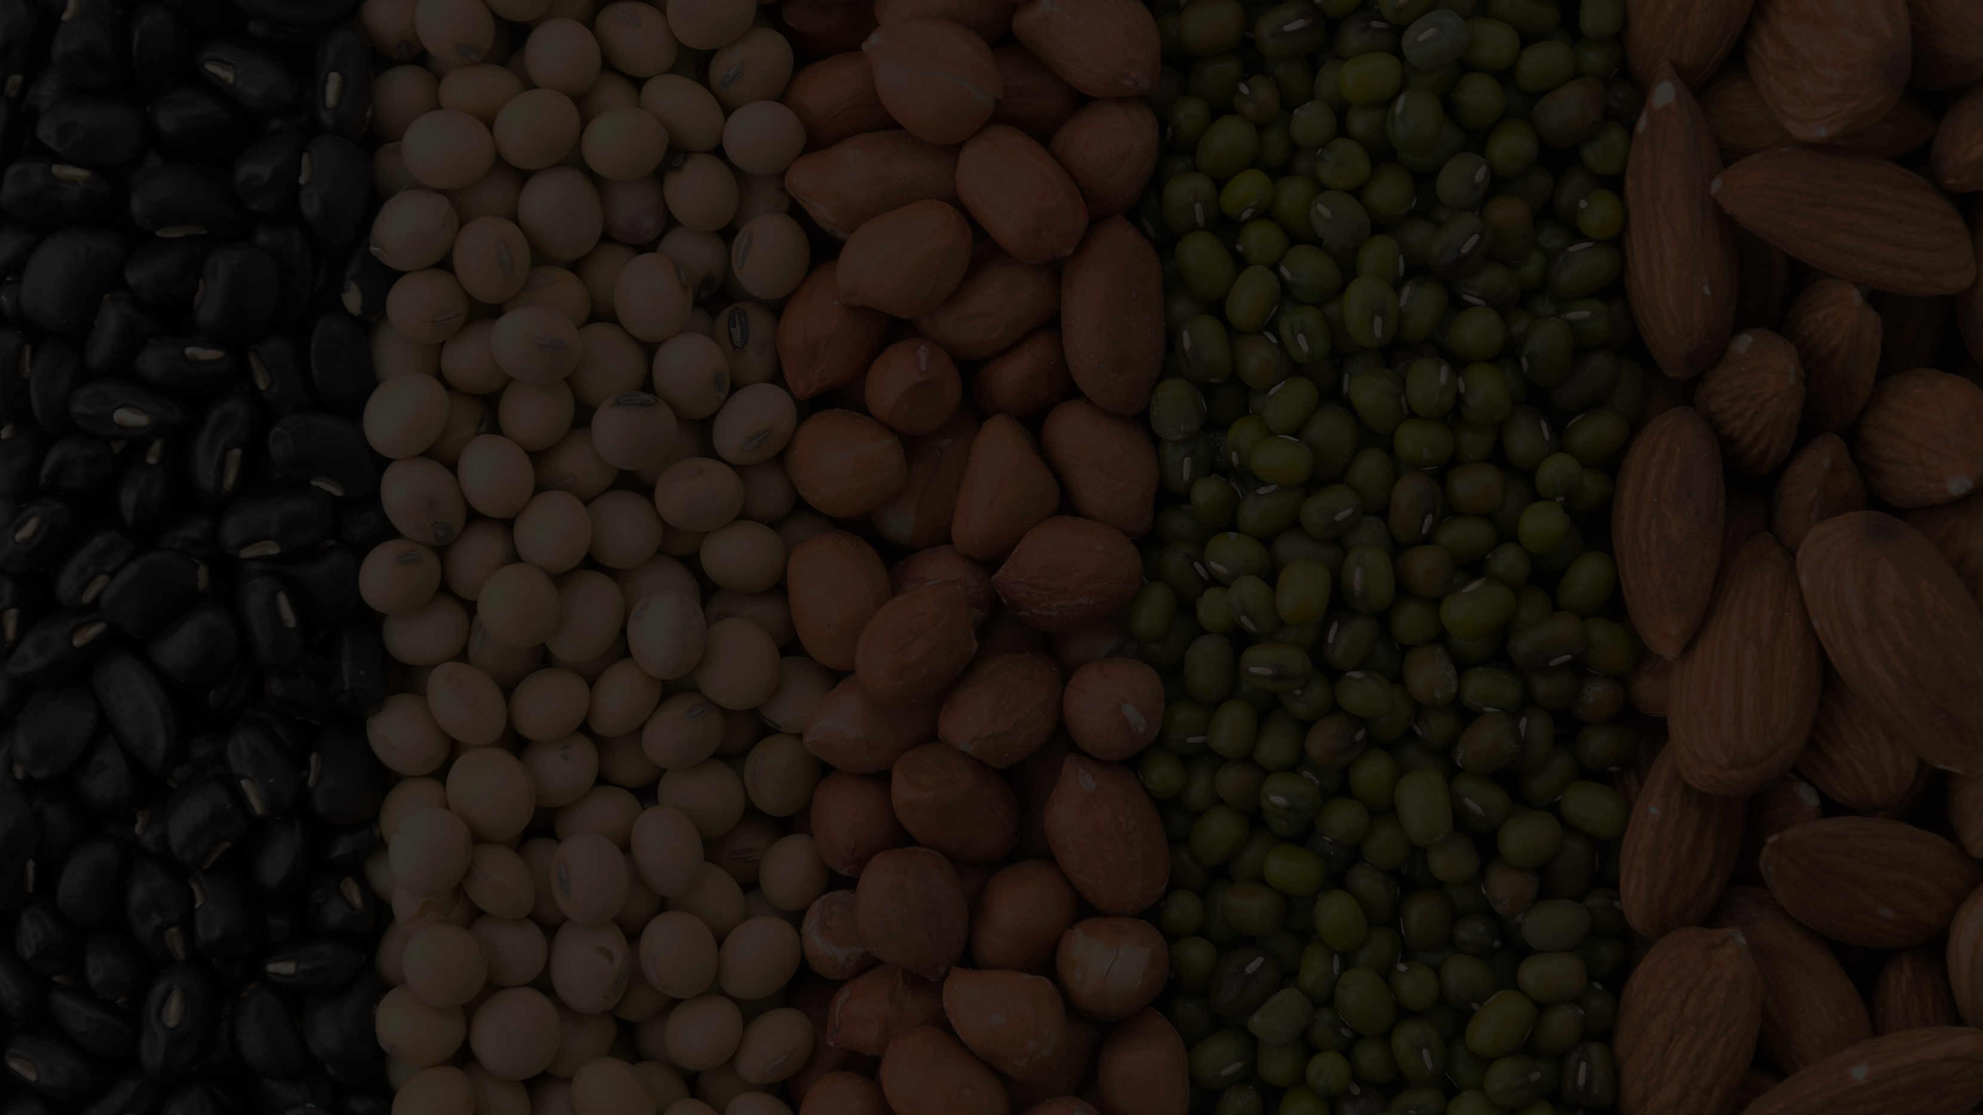
We guarantee our business partner
any brand, anywhere, anytime.
POWERPOINT TEMPLATE
franceajalimentaire@gmail.com
+(855) 17 909 642 | 16 909 642
www.franceajalimentaire.com

Slide 2
We guarantee our business partner
any brand, anywhere, anytime.
POWERPOINT TEMPLATE
Franceajalimentaire@gmail.com
+(855) 17 909 642 | 16 909 642
www.franceajalimentaire.com
Global Trade &
International Brand

Slide 3
We guarantee our business partner
any brand, anywhere, anytime.
POWERPOINT TEMPLATE
Global Trade &
International Brand
Franceajalimentaire@gmail.com
+(855) 17 909 642 | 16 909 642
www.franceajalimentaire.com

Slide 4
Our Categories
OUR CERTIFICATIONS
POWERPOINT TEMPLATE
Franceajalimentaire@gmail.com
+(855) 17 909 642 | 16 909 642
9001
22000

Slide 5
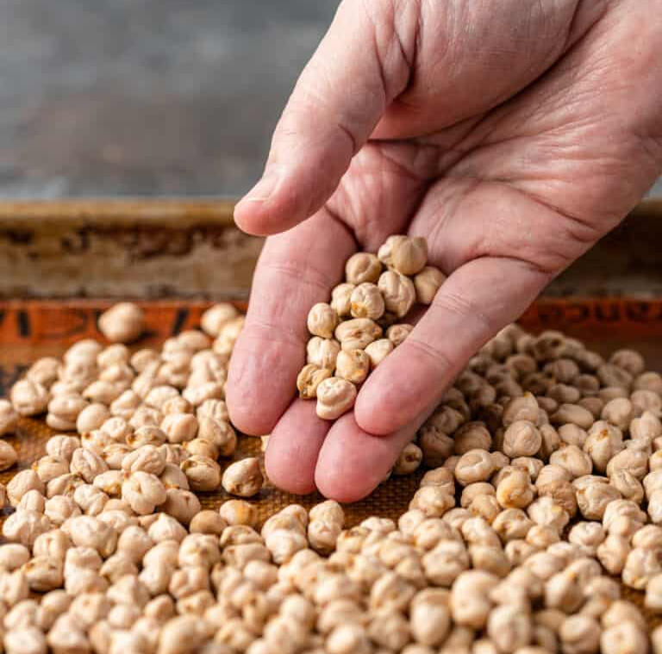
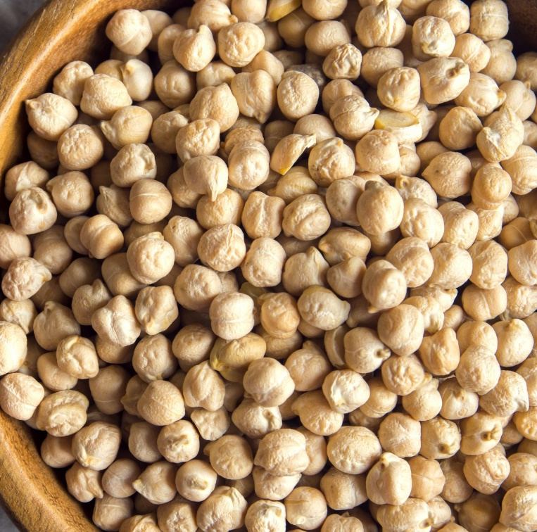
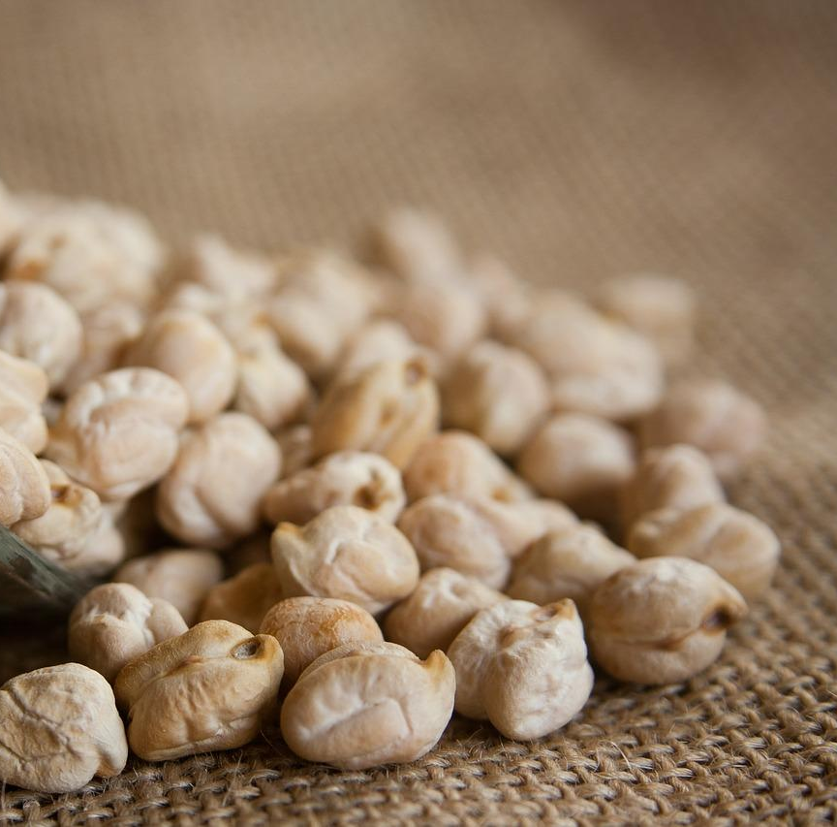
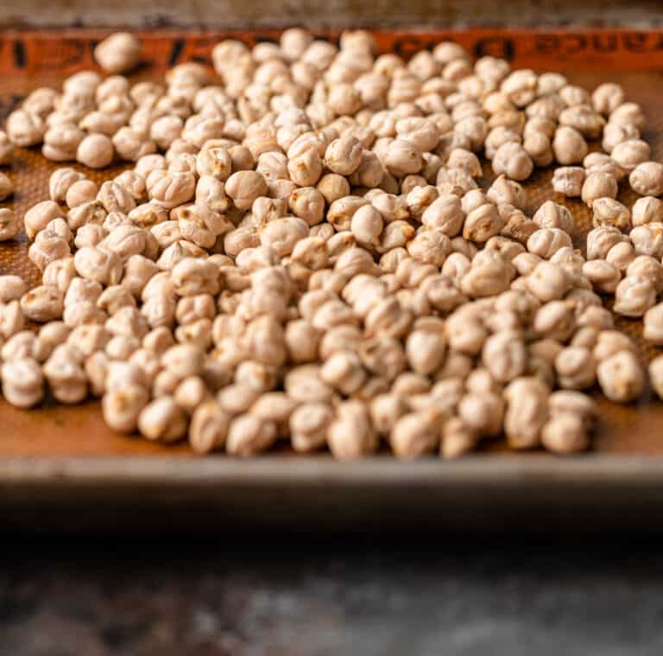
Natural raw whole dried Chickpeas beans
OUR CERTIFICATIONS
Natural raw whole dried Chickpeas for health food
Whole seed parts dried for using
100% Natural
High quality that could be proven
9001
22000
France Aj Alimentaire

Slide 6
Natural raw whole dried Chickpeas beans
SOYBEAN
Natural raw whole dried Chickpeas for health food
Whole seed parts dried for using
100% Natural
High quality that could be proven
Soy beans contain significant amounts of phytic acid, dietary minerals and B vitamins. Soy vegetable oil, used in food and industrial applications, is another product of processing the soybean crop. Soybean is the most important protein source for feed farm animals (that in turn yields animal protein for human consumption).
France Aj Alimentaire

Slide 7
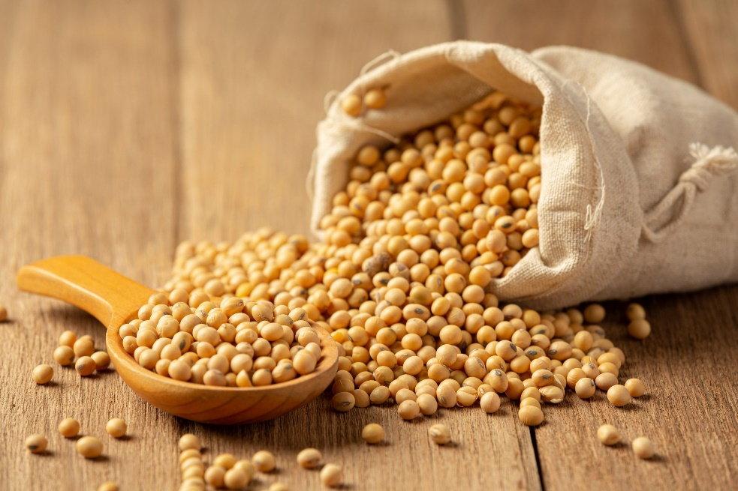
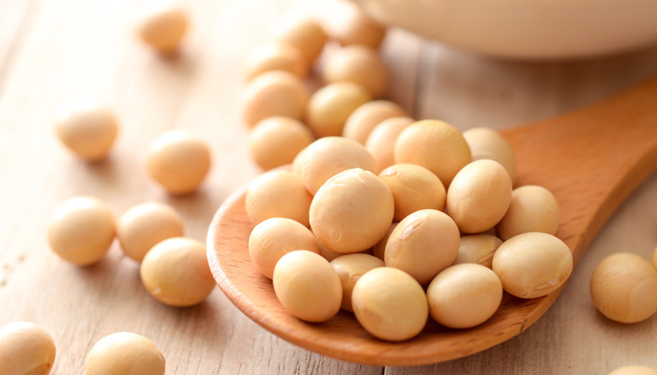
SOYBEAN
Soy beans contain significant amounts of phytic acid, dietary minerals and B vitamins. Soy vegetable oil, used in food and industrial applications, is another product of processing the soybean crop. Soybean is the most important protein source for feed farm animals (that in turn yields animal protein for human consumption).
France Aj Alimentaire
GENETICALLY MODIFIED
SOYBEANS
Most soy grown in the United States is GMO soy. Most GMO soy is used for food for animals, predominantly poultry and livestock, and making soybean oil. It is also used as ingredients (lecithin, emulsifiers, and proteins) in processed foods.

Slide 8
SOYBEAN
Soy beans contain significant amounts of phytic acid, dietary minerals and B vitamins. Soy vegetable oil, used in food and industrial applications, is another product of processing the soybean crop. Soybean is the most important protein source for feed farm animals (that in turn yields animal protein for human consumption).
France Aj Alimentaire
France Aj Alimentaire
GENETICALLY MODIFIED
SOYBEANS
Most soy grown in the United States is GMO soy. Most GMO soy is used for food for animals, predominantly poultry and livestock, and making soybean oil. It is also used as ingredients (lecithin, emulsifiers, and proteins) in processed foods.
There are different classifications of kidney beans, such as:
Red kidney bean (also known as: common kidney bean).
Light speckled kidney bean (and long shape light speckled kidney bean).
Red speckled kidney bean (and long shape light speckled kidney bean).
White kidney bean (also known as cannellini).

Slide 9
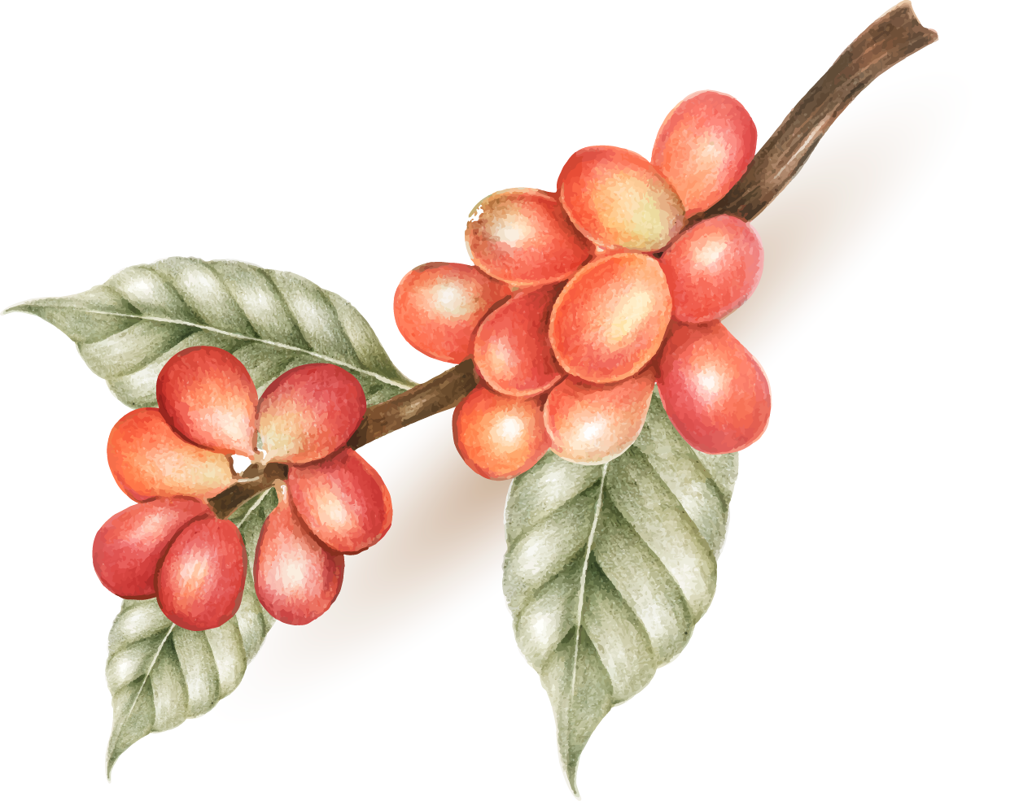
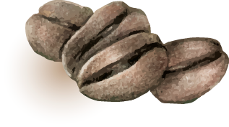
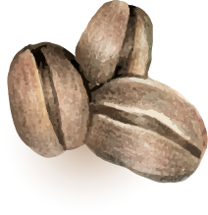
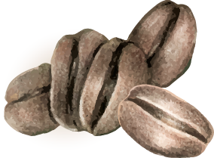
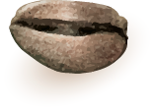
France Aj Alimentaire
COFFEE
BEAN
France Aj Alimentaire
KIDNEY
BEAN
GENETICALLY MODIFIED
SOYBEANS
There are different classifications of kidney beans, such as:
Red kidney bean (also known as: common kidney bean).
Light speckled kidney bean (and long shape light speckled kidney bean).
Red speckled kidney bean (and long shape light speckled kidney bean).
White kidney bean (also known as cannellini).
Most soy grown in the United States is GMO soy. Most GMO soy is used for food for animals, predominantly poultry and livestock, and making soybean oil. It is also used as ingredients (lecithin, emulsifiers, and proteins) in processed foods.
The coffee beans are hand selected from coffee cherries grown organically and developed naturally, in order to produce only the premium and specialty coffee. There is utilizes fully enclosed end-to-end processes in the production lifecycle from planting the seeds through to selective harvesting, processing, storage, roasting and packaging to ensure that the natural flavors of the coffee are preserved and rich in flavor and has its own unique aroma. The coffee cherries after picking will be peeled off, keeping the bean and husk that will be dried on the drying racks until reaching the required moisture, then they will be stored for further processes such as roasting. This wet process can balance coffee aroma and taste. Coffee cherries after cleaning will be dried on the drying racks during some weeks or even 1 month. This process method gives coffee beans the best natural rich sweetness.

Slide 10
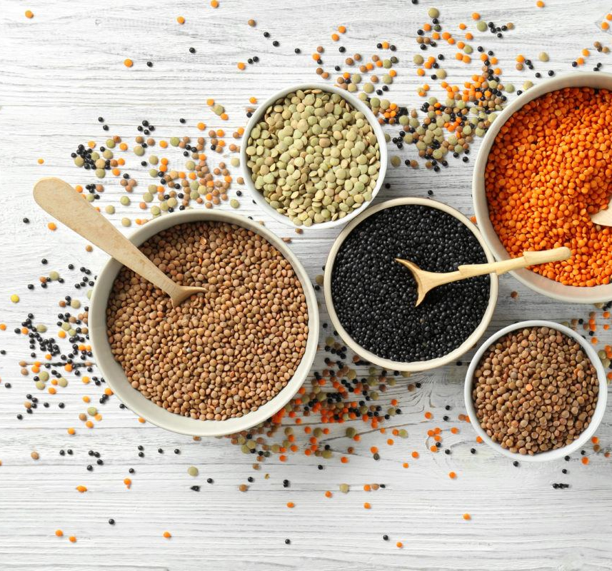
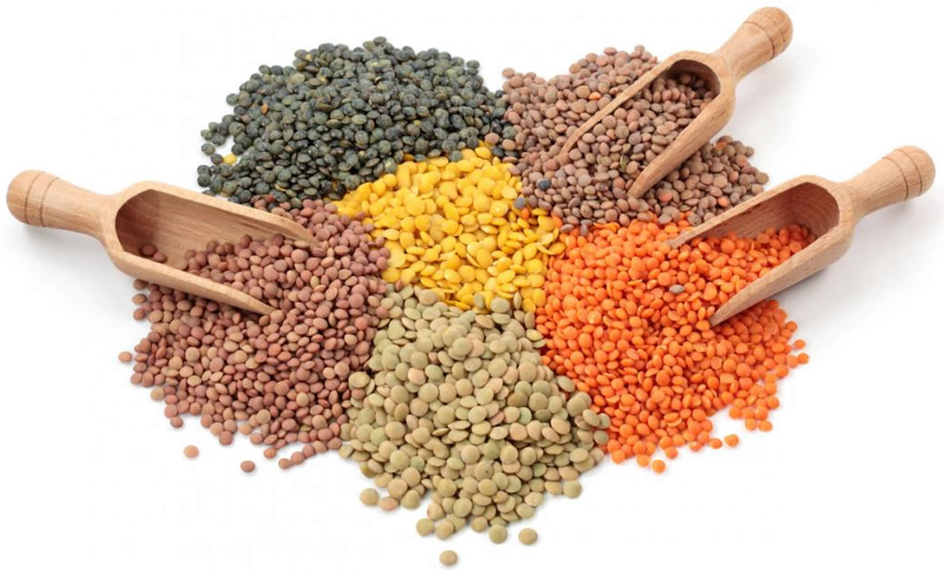
Lentils
COFFEE
BEAN
France Aj Alimentaire
Coffee Mondulkiri offers you good coffee like at the café, in the simple manner that you have always dreamed of at home. Our technology aims at helping you brew your favorite coffee easily and quickly. You follow your tastes and we put our experience at your service. You can personalize your coffee just as what you want, whenever you want. To taste it, just imagine it.
Amaze your guests with their favorite’s coffee, served straight away - just like in a café. A good coffee is a moment to be shared with those close to your heart.
Lentils also contain dietary fiber, folate, vitamin B1, and minerals. Red (or pink) lentils contain a lower concentration of fiber than green lentils (11% rather than 31%). Health magazine has selected lentils as one of the five healthiest foods. The low levels of Readily Digestible Starch (RDS) 5%, and high levels of Slowly Digested Starch (SDS) 30%, make lentils of great interest to people with diabetes. The remaining 65% of the starch is a resistant starch that is classified RS1, being a high quality resistant starch, which is 32% amylose. Lentils also have some anti-nutritional factors, such as trypsin inhibitors and relatively high phytate content. Trypsin is an enzyme involved in digestion, and phytates reduce the bio-availability of dietary minerals. The phytates can be reduced by soaking the lentils in warm water overnight.[citation needed] Lentils are a good source of iron, having over half of a person's daily iron allowance in a one cup serving.
With about 30% of their calories from protein, lentils have the third-highest level of protein, by weight, of any legume or nut, after soybeans and hemp.[4] Proteins include the essential amino acids isoleucine and lysine, and lentils are an inexpensive source of essential protein in many parts of the world, especially in West Asia and the Indian subcontinent, which have large vegetarian populations. Lentils are deficient in two essential amino acids, methionine and cysteine.
There are different classifications of kidney beans, such as:
Red kidney bean (also known as: common kidney bean).
Light speckled kidney bean (and long shape light speckled kidney bean).
Red speckled kidney bean (and long shape light speckled kidney bean).
White kidney bean (also known as cannellini).

Slide 11
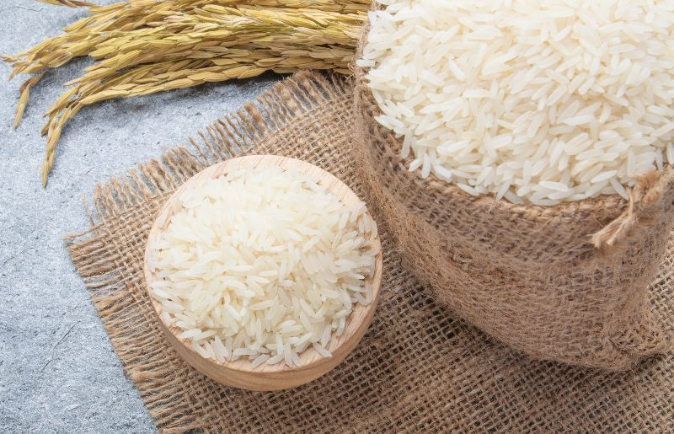
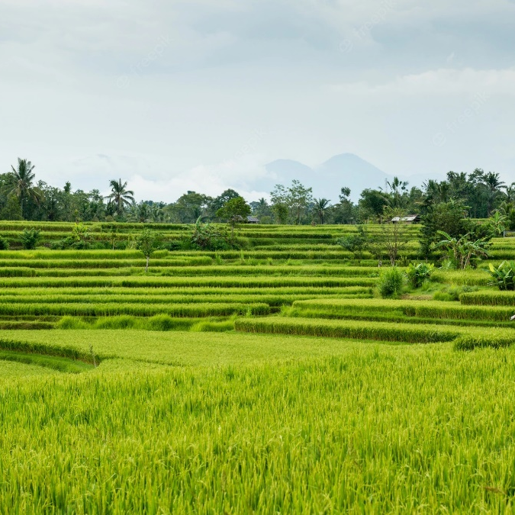
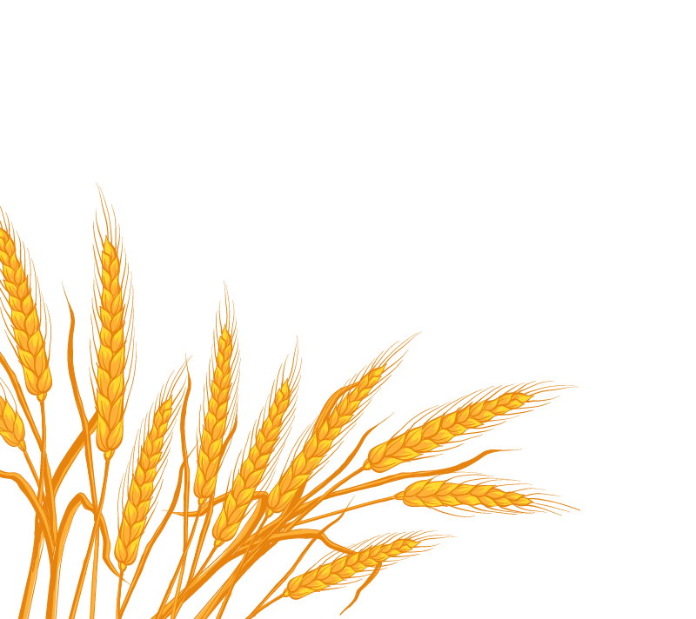
France Aj Alimentaire
COFFEE
BEAN
NATURAL RICE
Lentils
lentil is a bushy, annual shrub plant that is popular for its lens shaped seeds, which are consumed as food in stew or other forms all over the world. These seeds have a vast range of colors from yellow to red orange to green, brown and black and also have second highest levels of proteins and fiber after soybeans. The thin lentil plant, which is named Lens culinaris botanically, comes from the legume family and gains a height of 12 to 24 inches at maturity.
France Aj Alimentaire
Lentils also contain dietary fiber, folate, vitamin B1, and minerals. Red (or pink) lentils contain a lower concentration of fiber than green lentils (11% rather than 31%). Health magazine has selected lentils as one of the five healthiest foods. The low levels of Readily Digestible Starch (RDS) 5%, and high levels of Slowly Digested Starch (SDS) 30%, make lentils of great interest to people with diabetes. The remaining 65% of the starch is a resistant starch that is classified RS1, being a high quality resistant starch, which is 32% amylose. Lentils also have some anti-nutritional factors, such as trypsin inhibitors and relatively high phytate content. Trypsin is an enzyme involved in digestion, and phytates reduce the bio-availability of dietary minerals. The phytates can be reduced by soaking the lentils in warm water overnight.[citation needed] Lentils are a good source of iron, having over half of a person's daily iron allowance in a one cup serving.
The coffee beans are hand selected from coffee cherries grown organically and developed naturally, in order to produce only the premium and specialty coffee. There is utilizes fully enclosed end-to-end processes in the production lifecycle from planting the seeds through to selective harvesting, processing, storage, roasting and packaging to ensure that the natural flavors of the coffee are preserved and rich in flavor and has its own unique aroma. The coffee cherries after picking will be peeled off, keeping the bean and husk that will be dried on the drying racks until reaching the required moisture, then they will be stored for further processes such as roasting. This wet process can balance coffee aroma and taste. Coffee cherries after cleaning will be dried on the drying racks during some weeks or even 1 month. This process method gives coffee beans the best natural rich sweetness.
There are a variety of factors involved in choosing what rice will best suit your establishment's needs. Take a look at these 10 common types of rice to determine which grain size, texture, and flavor profile will work best for your next recipe.
Arborio Rice
Basmatic Rice
Black Rice
Bomba Rice
Brown Rice
Jasmine Rice
Long Grain White Rice
Parboiled Rice
Sticky Rice
Sushi Rice
With about 30% of their calories from protein, lentils have the third-highest level of protein, by weight, of any legume or nut, after soybeans and hemp.[4] Proteins include the essential amino acids isoleucine and lysine, and lentils are an inexpensive source of essential protein in many parts of the world, especially in West Asia and the Indian subcontinent, which have large vegetarian populations. Lentils are deficient in two essential amino acids, methionine and cysteine.

Slide 12
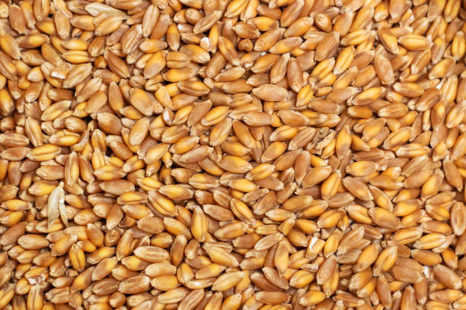
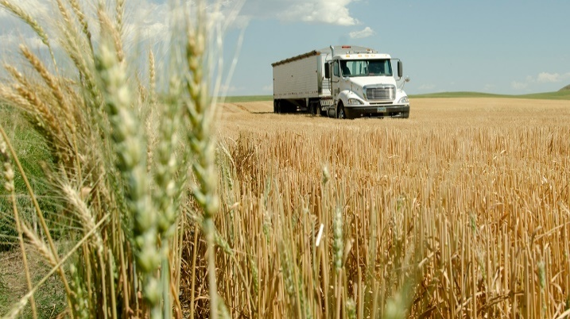
France Aj Alimentaire
NATURAL RICE
HARD RED
WINTER WHEAT
There are a variety of factors involved in choosing what rice will best suit your establishment's needs. Take a look at these 10 common types of rice to determine which grain size, texture, and flavor profile will work best for your next recipe.
Arborio Rice
Basmatic Rice
Black Rice
Bomba Rice
Brown Rice
Jasmine Rice
Long Grain White Rice
Parboiled Rice
Sticky Rice
Sushi Rice
Hard red winter wheat is the most common variation of wheat grown in the US. The majority of it is grown in the Midwest Plains states. Like all winter wheat, it is planted in the fall and grows only a few inches until winter causes it to go dormant. Many home-flour millers use hard red winter wheat because of its stronger flavor than white wheat alternatives.
It is known as “red wheat” because of its reddish hued husk. The berries appear somewhat darker than most whites. With a protein content of about 10.5%, it is quite versatile as a general purpose flour. Winter wheats often produce a higher yield of berries, depending on time of sowing. Hard winter wheats can also have higher gluten content than spring varieties.
France Aj Alimentaire

Slide 13
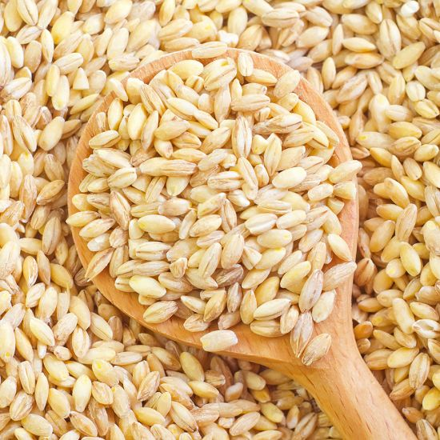
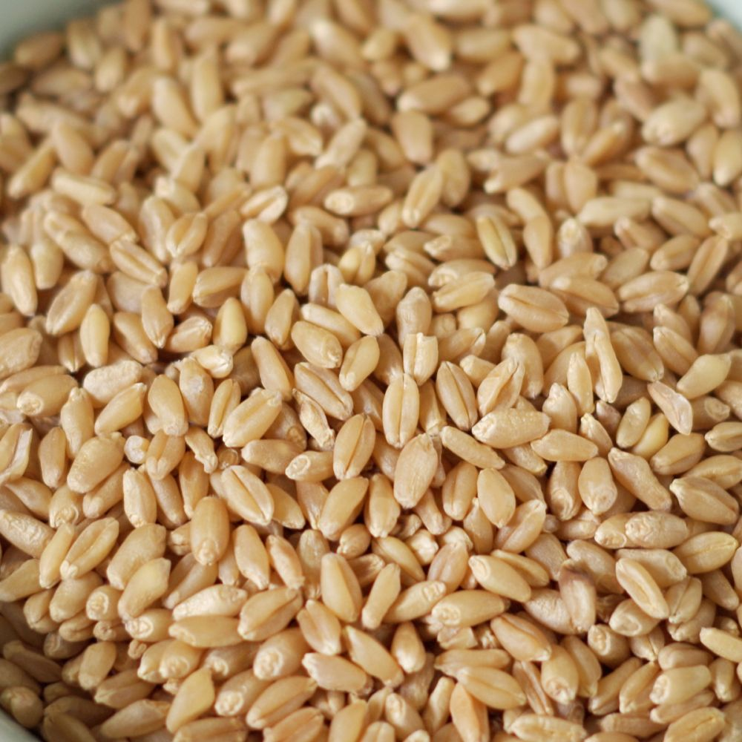
NATURAL RICE
HARD RED
WINTER WHEAT
France Aj Alimentaire
Hard red winter wheat is the most common variation of wheat grown in the US. The majority of it is grown in the Midwest Plains states. Like all winter wheat, it is planted in the fall and grows only a few inches until winter causes it to go dormant. Many home-flour millers use hard red winter wheat because of its stronger flavor than white wheat alternatives.
It is known as “red wheat” because of its reddish hued husk. The berries appear somewhat darker than most whites. With a protein content of about 10.5%, it is quite versatile as a general purpose flour. Winter wheats often produce a higher yield of berries, depending on time of sowing. Hard winter wheats can also have higher gluten content than spring varieties.
There are a variety of factors involved in choosing what rice will best suit your establishment's needs. Take a look at these 10 common types of rice to determine which grain size, texture, and flavor profile will work best for your next recipe.
Arborio Rice
Basmatic Rice
Black Rice
Bomba Rice
Brown Rice
Jasmine Rice
Long Grain White Rice
Parboiled Rice
Sticky Rice
Sushi Rice
France Aj Alimentaire
HARD WHITE
WHEAT
Hard white wheat berries when ground into flour is the best choice for light colored breads. Because it is a "hard" wheat with high gluten content, it is good for bread, yet because of it’s light color it can easily be used in French bread and pizza crusts for the nutrition of whole wheat without the "brown bread" look.

Slide 14
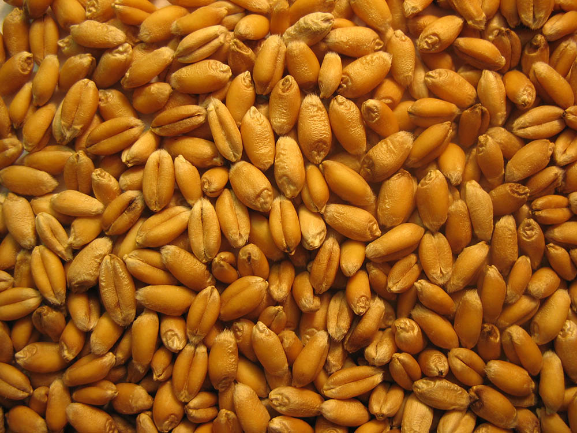
France Aj Alimentaire
SOFT RED
WINTER WHEAT
Compared to the hard red varieties of wheat, soft red winter wheat has a comparatively low protein content, which makes it a leading choice for bakers striving for soft pastries and pan breads. In a more coarsely ground form, this wheat is also used to make pasta and cereal. Because it is a softer variety of wheat, it grinds more easily than the hard wheats. Like the other red varieties, the husk of soft red winter wheat has a reddish hue and yields a slightly darker color flour than the white wheat alternatives.
Winter wheat is planted in the fall and harvested in late spring or early summer. In the US, winter wheats are much more commonly grown and harvested than spring variants.
HARD WHITE
WHEAT
Hard white wheat berries when ground into flour is the best choice for light colored breads. Because it is a "hard" wheat with high gluten content, it is good for bread, yet because of it’s light color it can easily be used in French bread and pizza crusts for the nutrition of whole wheat without the "brown bread" look.
HARD RED
WINTER WHEAT
Hard red winter wheat is the most common variation of wheat grown in the US. The majority of it is grown in the Midwest Plains states. Like all winter wheat, it is planted in the fall and grows only a few inches until winter causes it to go dormant. Many home-flour millers use hard red winter wheat because of its stronger flavor than white wheat alternatives.
It is known as “red wheat” because of its reddish hued husk. The berries appear somewhat darker than most whites. With a protein content of about 10.5%, it is quite versatile as a general purpose flour. Winter wheats often produce a higher yield of berries, depending on time of sowing. Hard winter wheats can also have higher gluten content than spring varieties.

Slide 15
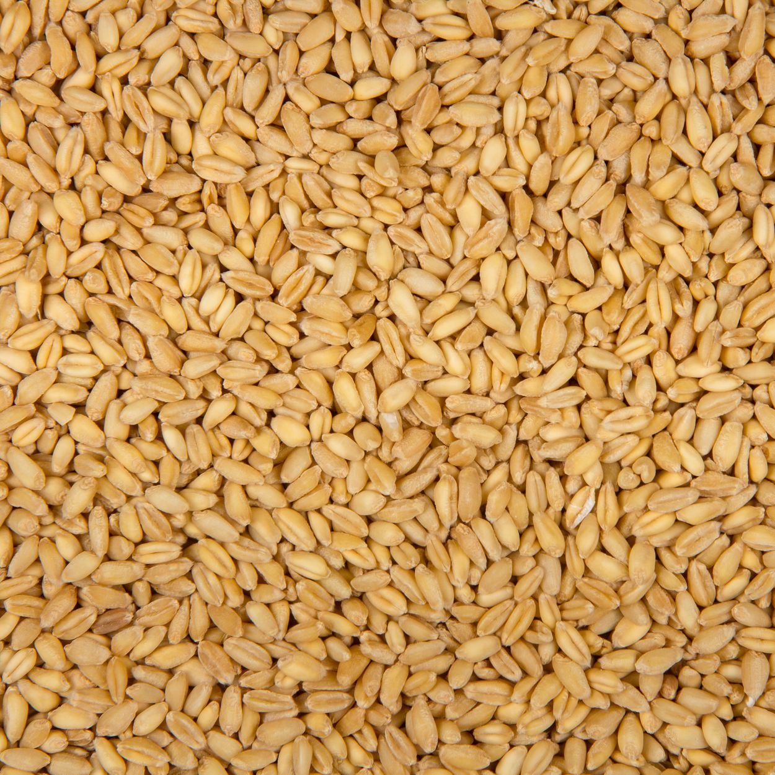
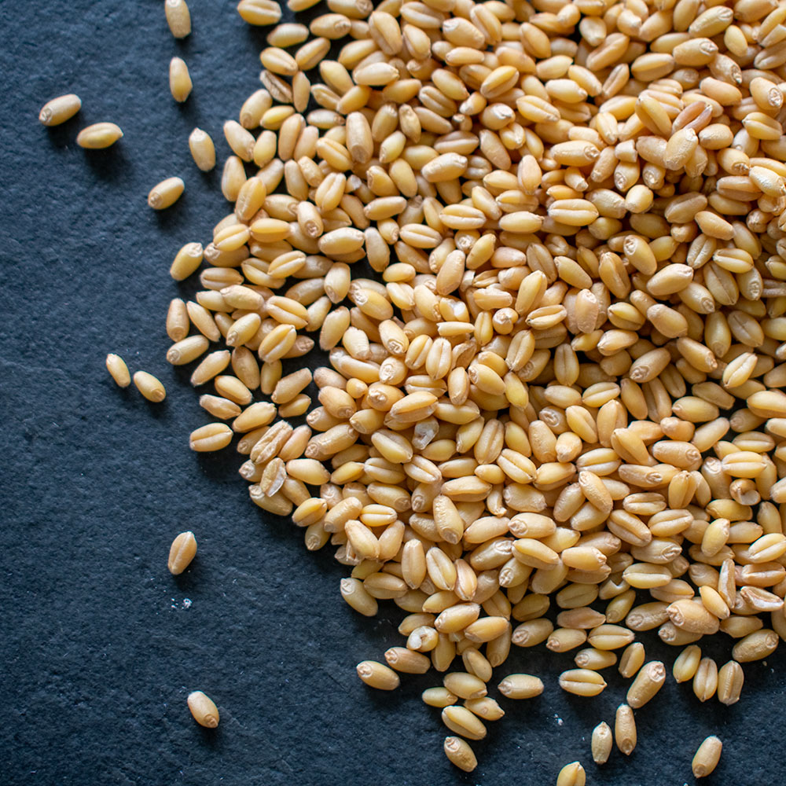
France Aj Alimentaire
SOFT WHITE
WHEAT
SOFT RED
WINTER WHEAT
Soft White Wheat is a light tan grain that is shorter in length and much plumper than hard wheats. It is an important ingredient in bakery products other than breads due to a more delicate gluten structure than hard wheats. Therefore, it is primarily used in pastry flours that have lighter and flakier characteristics such as pastries, cakes and flatbreads. With a mild whole grain flavor it is a good source of protein, dietary fiber, phosphorus and manganese.
Compared to the hard red varieties of wheat, soft red winter wheat has a comparatively low protein content, which makes it a leading choice for bakers striving for soft pastries and pan breads. In a more coarsely ground form, this wheat is also used to make pasta and cereal. Because it is a softer variety of wheat, it grinds more easily than the hard wheats. Like the other red varieties, the husk of soft red winter wheat has a reddish hue and yields a slightly darker color flour than the white wheat alternatives.
Winter wheat is planted in the fall and harvested in late spring or early summer. In the US, winter wheats are much more commonly grown and harvested than spring variants.
HARD WHITE
WHEAT
Hard white wheat berries when ground into flour is the best choice for light colored breads. Because it is a "hard" wheat with high gluten content, it is good for bread, yet because of it’s light color it can easily be used in French bread and pizza crusts for the nutrition of whole wheat without the "brown bread" look.

Slide 16
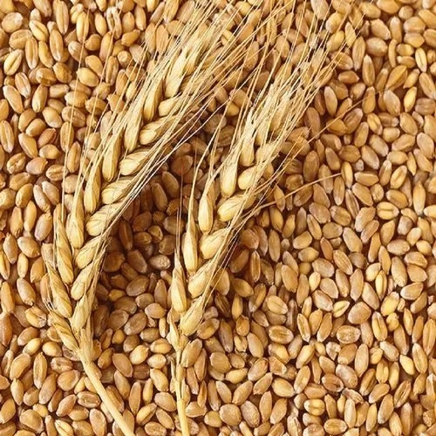
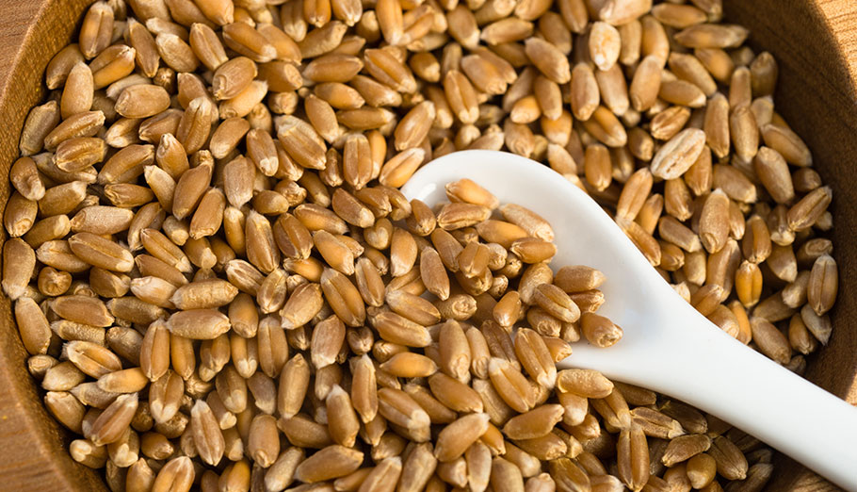
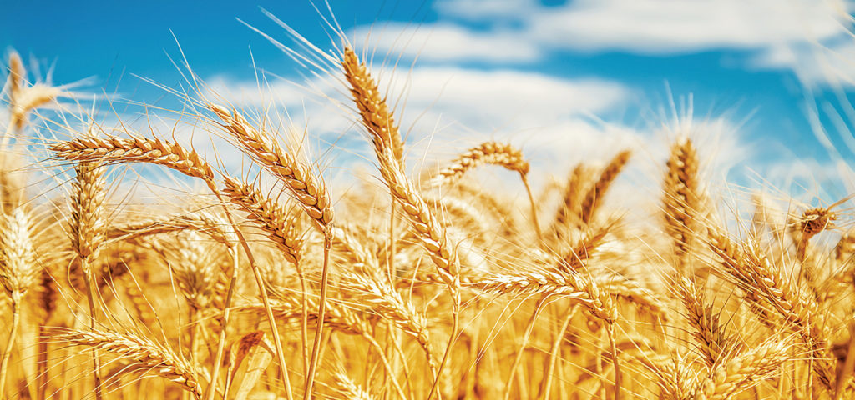
HARD RED
STRING WHEAT
Hard red spring wheat flour is named for its berries, which are closely related to hard red winter wheat. This variety is usually grown in the northern United States and Canada. Planted in spring and harvested in the fall, hard red spring wheat has the highest protein content of all the wheat varieties (13.5%). Although it is one of the hardest wheat types, it is widely used to make flour for bread, croissants and pizza flour. Many bakers will add this to flour made from softer wheat for the extra protein content it imparts to the bread. Like hard red winter wheat, hard red spring wheat has a reddish colored husk and produces a slightly darker flour than a white wheat. Spring wheat tends to have more gluten content than the more common winter wheat varieties.
Reds are generally considered more nutty or bitter than their white wheat counterparts. This can be a benefit or a detriment, depending on what flavors you are trying to produce.
SOFT WHITE
WHEAT
France Aj Alimentaire
Soft White Wheat is a light tan grain that is shorter in length and much plumper than hard wheats. It is an important ingredient in bakery products other than breads due to a more delicate gluten structure than hard wheats. Therefore, it is primarily used in pastry flours that have lighter and flakier characteristics such as pastries, cakes and flatbreads. With a mild whole grain flavor it is a good source of protein, dietary fiber, phosphorus and manganese.

Slide 17
France Aj Alimentaire
DRUM WHEAT
HARD RED
STRING WHEAT
Durum wheat is very hard, which facilitates high yield of semolina. The break system for durum wheat is extended to allow gradual breakdown of kernels to achieve maximum production of semolina and minimum production of flour. Purified semolina from the break system is uniformly sized and freed from adhering bran by repeated sizing, grading, and purification. Most semolina is from sizing purifiers, making durum mills readily recognized by the large number of purifiers. The traditional durum wheat semolina particle size is coarser relative to what is used by modern pasta processors today, which tends to be finer. Although durum wheat is primarily associated with pasta production, a very high percentage of durum wheat is used for the production of couscous, a popular food in North Africa. A considerable portion of durum wheat is also used for bread baking, which includes flat-breads as well as hearth-style bread.
Hard red spring wheat flour is named for its berries, which are closely related to hard red winter wheat. This variety is usually grown in the northern United States and Canada. Planted in spring and harvested in the fall, hard red spring wheat has the highest protein content of all the wheat varieties (13.5%). Although it is one of the hardest wheat types, it is widely used to make flour for bread, croissants and pizza flour. Many bakers will add this to flour made from softer wheat for the extra protein content it imparts to the bread. Like hard red winter wheat, hard red spring wheat has a reddish colored husk and produces a slightly darker flour than a white wheat. Spring wheat tends to have more gluten content than the more common winter wheat varieties.
Reds are generally considered more nutty or bitter than their white wheat counterparts. This can be a benefit or a detriment, depending on what flavors you are trying to produce.
France Aj Alimentaire

Slide 18
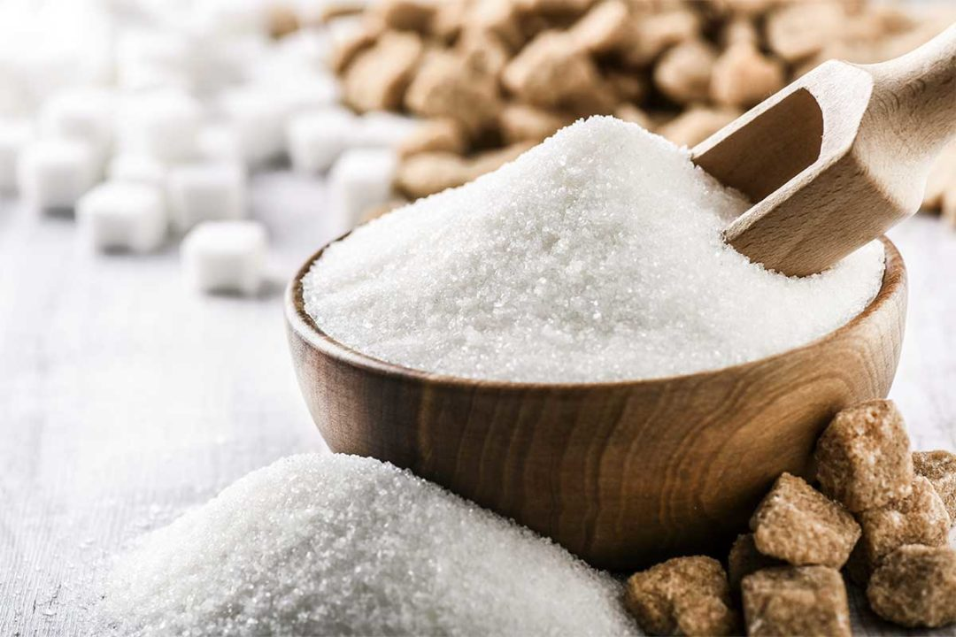
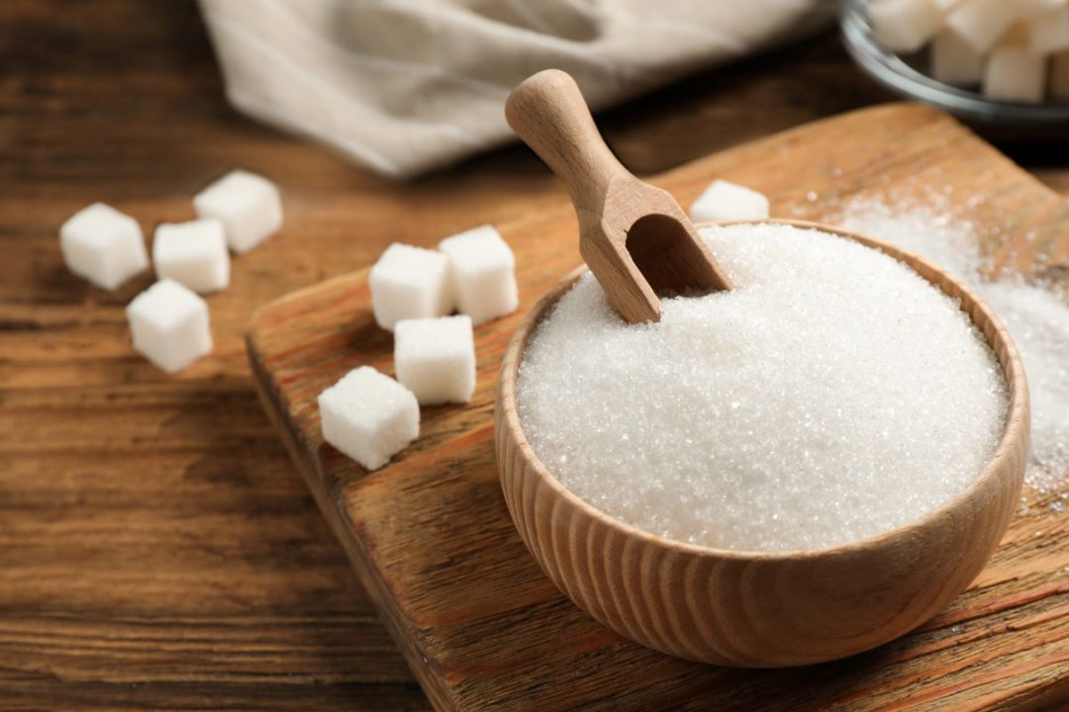
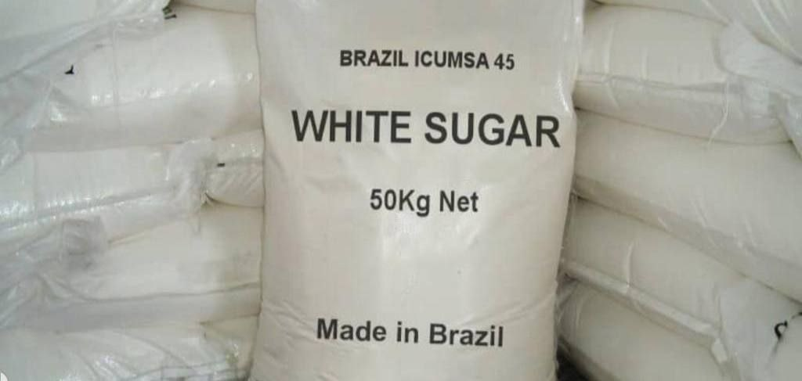
SUGAR
Brazilian Sugar - Introduced during the colonial period, the sugarcane has become one of the main crops of the Brazilian economy. Brazil is not only the largest producer of sugar cane, but also the first in the world in the production of sugar and ethanol and conquest, increasingly, the foreign market with the use of biofuels as an energy alternative.
The sugarcane is an example of renewable and versatile culture, which can be used as a source of clean energy and raw material products. Brazil is now the world's largest producer of sugarcane. The modernization of 430 plants in operation in the country, with the adoption of new technologies from planting to the production of sugar, ethanol and bioelectricity, strengthened the sector, recognized worldwide for its pioneering and productive efficiency.
Responsible for more than half the sugar traded in the world, the country should achieve average rate of increase in production of 3.25% until 2018/19, and reap 47.34 million tones of iron ore, which corresponds to an increase of 14.6 million tones for the period 2007/2008. For exports, the volume planned for 2019 is 32.6 million tons. It is responsible for 490 million tons of sugarcane per year (2011/2012) and about 90% of the Brazilian production of sugar cane is harvested in South-Central region, especially in São Paulo, which is accounting for 60%.
France Aj Alimentaire
DRUM WHEAT
HARD RED
STRING WHEAT
Durum wheat is very hard, which facilitates high yield of semolina. The break system for durum wheat is extended to allow gradual breakdown of kernels to achieve maximum production of semolina and minimum production of flour. Purified semolina from the break system is uniformly sized and freed from adhering bran by repeated sizing, grading, and purification. Most semolina is from sizing purifiers, making durum mills readily recognized by the large number of purifiers. The traditional durum wheat semolina particle size is coarser relative to what is used by modern pasta processors today, which tends to be finer. Although durum wheat is primarily associated with pasta production, a very high percentage of durum wheat is used for the production of couscous, a popular food in North Africa. A considerable portion of durum wheat is also used for bread baking, which includes flat-breads as well as hearth-style bread.
Hard red spring wheat flour is named for its berries, which are closely related to hard red winter wheat. This variety is usually grown in the northern United States and Canada. Planted in spring and harvested in the fall, hard red spring wheat has the highest protein content of all the wheat varieties (13.5%). Although it is one of the hardest wheat types, it is widely used to make flour for bread, croissants and pizza flour. Many bakers will add this to flour made from softer wheat for the extra protein content it imparts to the bread. Like hard red winter wheat, hard red spring wheat has a reddish colored husk and produces a slightly darker flour than a white wheat. Spring wheat tends to have more gluten content than the more common winter wheat varieties.
Reds are generally considered more nutty or bitter than their white wheat counterparts. This can be a benefit or a detriment, depending on what flavors you are trying to produce.
France Aj Alimentaire

Slide 19
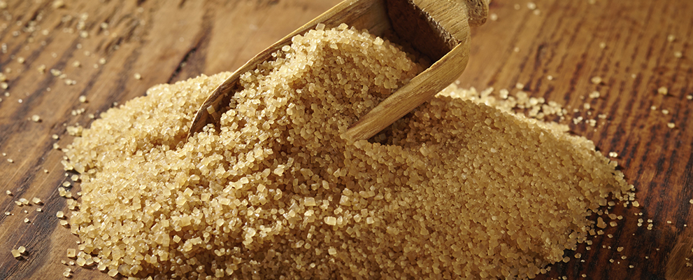
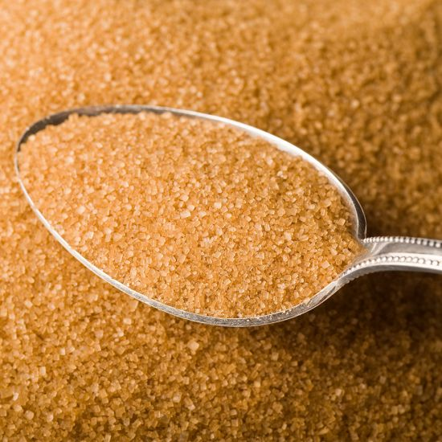
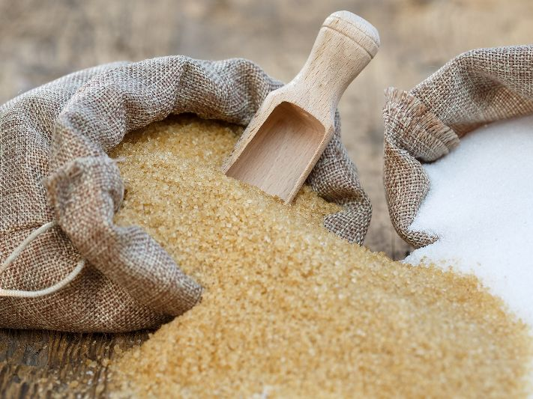
SUGAR
France Aj Alimentaire
Brazilian Sugar - Introduced during the colonial period, the sugarcane has become one of the main crops of the Brazilian economy. Brazil is not only the largest producer of sugar cane, but also the first in the world in the production of sugar and ethanol and conquest, increasingly, the foreign market with the use of biofuels as an energy alternative.
The sugarcane is an example of renewable and versatile culture, which can be used as a source of clean energy and raw material products. Brazil is now the world's largest producer of sugarcane. The modernization of 430 plants in operation in the country, with the adoption of new technologies from planting to the production of sugar, ethanol and bioelectricity, strengthened the sector, recognized worldwide for its pioneering and productive efficiency.
Responsible for more than half the sugar traded in the world, the country should achieve average rate of increase in production of 3.25% until 2018/19, and reap 47.34 million tones of iron ore, which corresponds to an increase of 14.6 million tones for the period 2007/2008. For exports, the volume planned for 2019 is 32.6 million tons. It is responsible for 490 million tons of sugarcane per year (2011/2012) and about 90% of the Brazilian production of sugar cane is harvested in South-Central region, especially in São Paulo, which is accounting for 60%.
ICUMSA
900-120-RAW
DRUM WHEAT
France Aj Alimentaire
GOLDEN BROWN SURGAR
In the past decade (2000-2009), Brazil’s proportion of worldwide exports in raw sugar has progressed from 7% to 62%.
Général Afitex has developed their sugar sales activity around solid relations with Brazilian producers to guarantee a supply of sugar that is completely safe, traceable and reliable
Durum wheat is very hard, which facilitates high yield of semolina. The break system for durum wheat is extended to allow gradual breakdown of kernels to achieve maximum production of semolina and minimum production of flour. Purified semolina from the break system is uniformly sized and freed from adhering bran by repeated sizing, grading, and purification. Most semolina is from sizing purifiers, making durum mills readily recognized by the large number of purifiers. The traditional durum wheat semolina particle size is coarser relative to what is used by modern pasta processors today, which tends to be finer. Although durum wheat is primarily associated with pasta production, a very high percentage of durum wheat is used for the production of couscous, a popular food in North Africa. A considerable portion of durum wheat is also used for bread baking, which includes flat-breads as well as hearth-style bread.

Slide 20
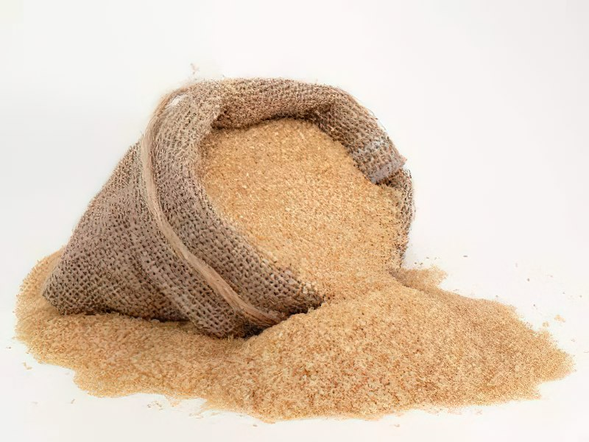
SUGAR
Brazilian Sugar - Introduced during the colonial period, the sugarcane has become one of the main crops of the Brazilian economy. Brazil is not only the largest producer of sugar cane, but also the first in the world in the production of sugar and ethanol and conquest, increasingly, the foreign market with the use of biofuels as an energy alternative.
The sugarcane is an example of renewable and versatile culture, which can be used as a source of clean energy and raw material products. Brazil is now the world's largest producer of sugarcane. The modernization of 430 plants in operation in the country, with the adoption of new technologies from planting to the production of sugar, ethanol and bioelectricity, strengthened the sector, recognized worldwide for its pioneering and productive efficiency.
Responsible for more than half the sugar traded in the world, the country should achieve average rate of increase in production of 3.25% until 2018/19, and reap 47.34 million tones of iron ore, which corresponds to an increase of 14.6 million tones for the period 2007/2008. For exports, the volume planned for 2019 is 32.6 million tons. It is responsible for 490 million tons of sugarcane per year (2011/2012) and about 90% of the Brazilian production of sugar cane is harvested in South-Central region, especially in São Paulo, which is accounting for 60%.
France Aj Alimentaire
GOLDEN BROWN SURGAR
ICUMSA
900-120-RAW
In the past decade (2000-2009), Brazil’s proportion of worldwide exports in raw sugar has progressed from 7% to 62%.
Général Afitex has developed their sugar sales activity around solid relations with Brazilian producers to guarantee a supply of sugar that is completely safe, traceable and reliable
France Aj Alimentaire
LIGHT BROWN SURGAR
ICUMSA 600-800 - RAW
ICUMSA 600-800 – Consumable Brown Sugar: This sugar is consumable by humans, and is generally regarded as being very tasty on porridge.

Slide 21
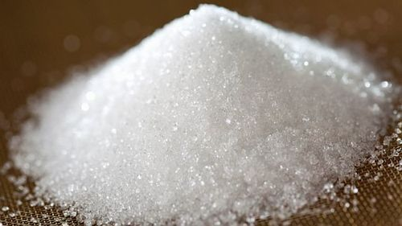
GOLDEN BROWN SURGAR
ICUMSA
900-120-RAW
In the past decade (2000-2009), Brazil’s proportion of worldwide exports in raw sugar has progressed from 7% to 62%.
Général Afitex has developed their sugar sales activity around solid relations with Brazilian producers to guarantee a supply of sugar that is completely safe, traceable and reliable
France Aj Alimentaire
LIGHT BROWN SURGAR
ICUMSA 600-800 - RAW
ICUMSA 600-800 – Consumable Brown Sugar: This sugar is consumable by humans, and is generally regarded as being very tasty on porridge.
USAGES
France Aj Alimentaire
EXTRA FINE
CRYSTAL ICUMSA 150 / S30
It is most commonly used in our daily lives, White sugar is produced for day to day consumption. Prevails mostly in countries which have sugarcane plantation. This is otherwise called as table Sugar.

Slide 22
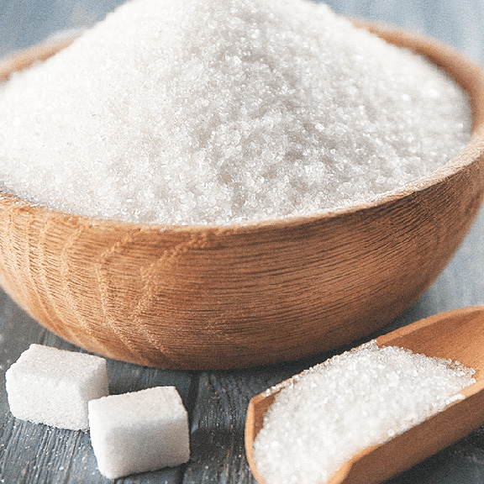
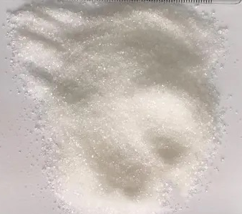
EXTRA FINE CRYSTAL
SUGAR ICUMSA 45
It is a leading supplier of Brazilian sugar. we offer the best quality Brazilian sugar and offer eco friendly packing to our esteemed clientele. We offer unadulterated content to the clients and do not compromise on the quality of the sugar. The Brazilian sugar is manufactured in sophisticated units and hence, is in huge demand in Brazil. variety : fine crystal sugar big granulated sugar extra fine crystal sugar powder fine crystal sugar raw sugar .
LIGHT BROWN SURGAR
ICUMSA 600-800 - RAW
ICUMSA 600-800 – Consumable Brown Sugar: This sugar is consumable by humans, and is generally regarded as being very tasty on porridge.
France Aj Alimentaire
EXTRA FINE
CRYSTAL ICUMSA 150 / S30
USAGES
It is most commonly used in our daily lives, White sugar is produced for day to day consumption. Prevails mostly in countries which have sugarcane plantation. This is otherwise called as table Sugar.
France Aj Alimentaire

Slide 23
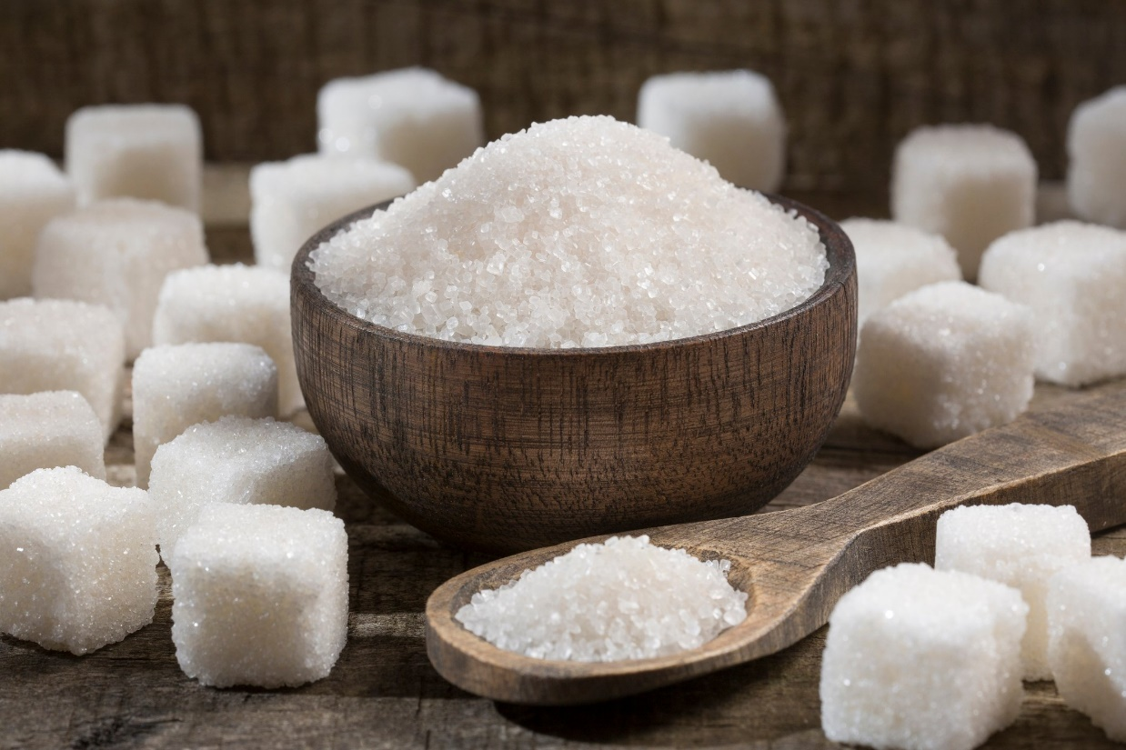
France Aj Alimentaire
EXTRA FINE CRYSTAL
SUGAR ICUMSA 45
It is a leading supplier of Brazilian sugar. we offer the best quality Brazilian sugar and offer eco friendly packing to our esteemed clientele. We offer unadulterated content to the clients and do not compromise on the quality of the sugar. The Brazilian sugar is manufactured in sophisticated units and hence, is in huge demand in Brazil. variety : fine crystal sugar big granulated sugar extra fine crystal sugar powder fine crystal sugar raw sugar .
USAGES
EXTRA FINE
CRYSTAL ICUMSA 150 / S30
France Aj Alimentaire
FINE CRYSTAL SUGAR
ICUMSA 150
It is most commonly used in our daily lives, White sugar is produced for day to day consumption. Prevails mostly in countries which have sugarcane plantation. This is otherwise called as table Sugar.
ICUMSA 150 Sugar - Brazil today is the largest producer of sugarcane in the world, in addition to being the first in the production of ethanol and sugar, being responsible for 48% of world exports of this commodity. The term ICUMSA is an acronym called the International Commission for Uniform Methods of Sugar Analysis, or the International Commission for Uniform Methods of Sugar Analysis in free translation.

Slide 24
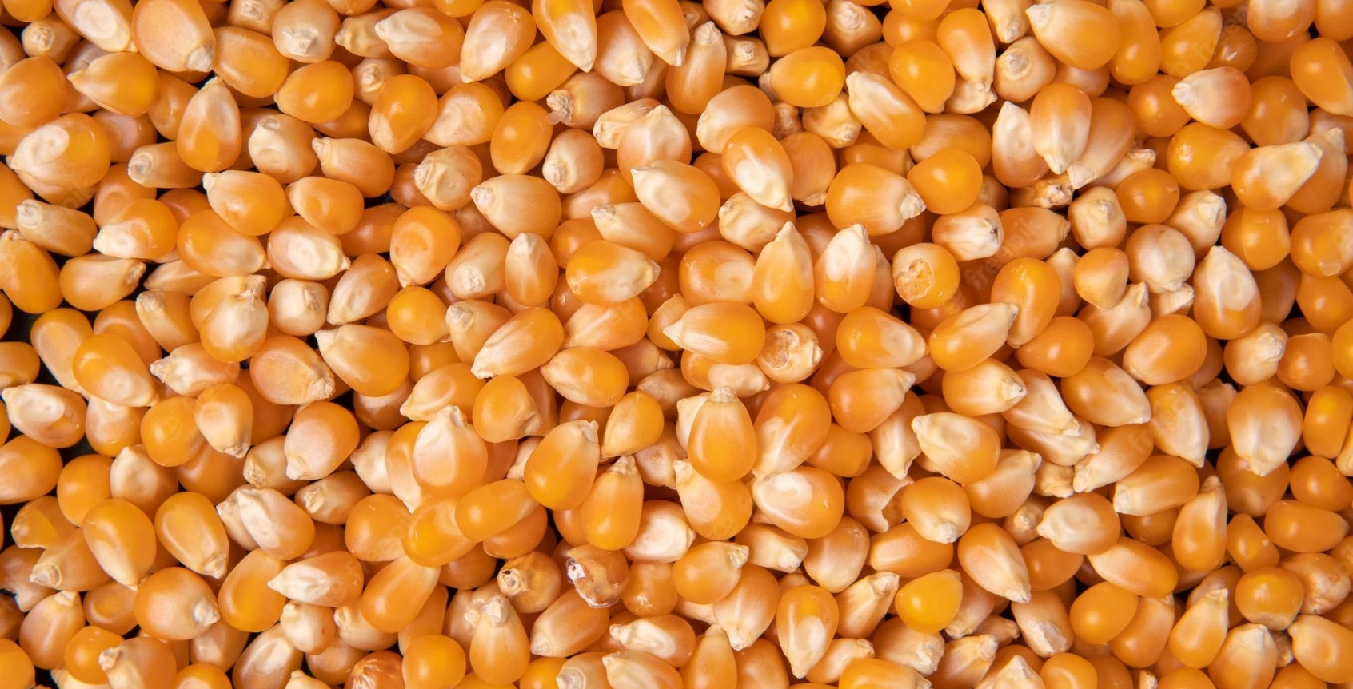
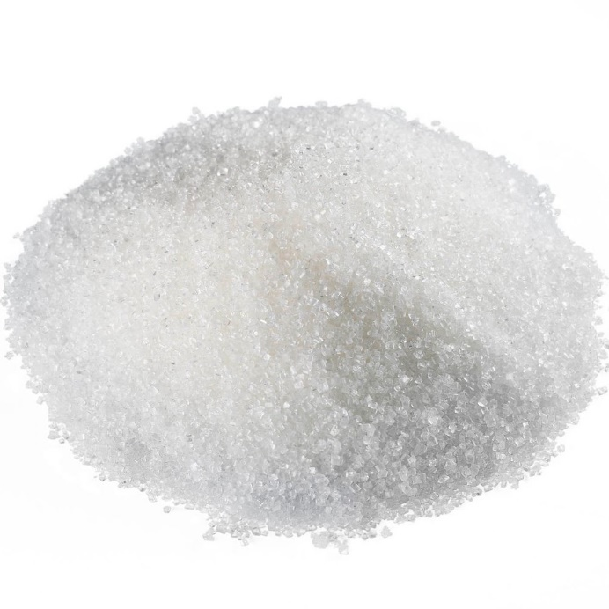
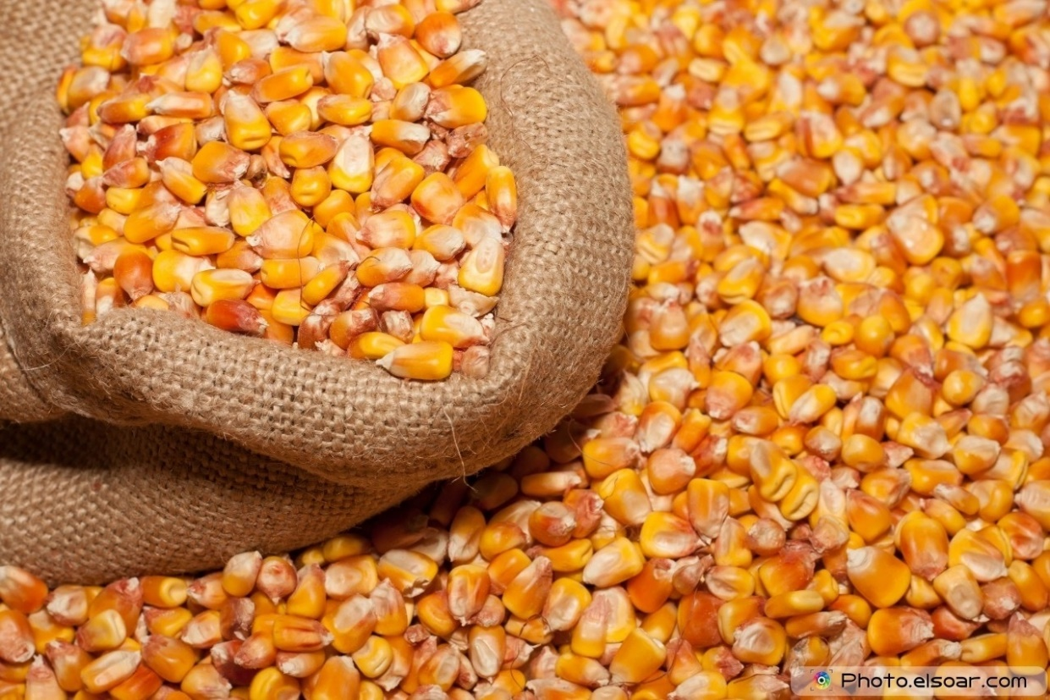
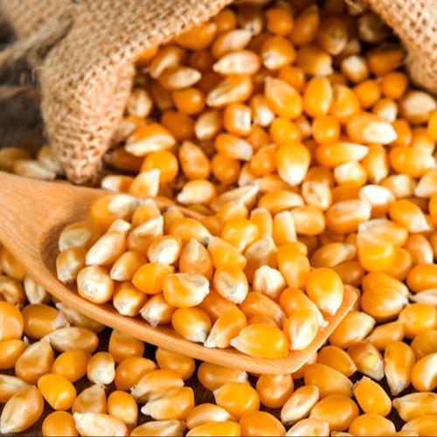
EXTRA FINE CRYSTAL
SUGAR ICUMSA 45
It is a leading supplier of Brazilian sugar. we offer the best quality Brazilian sugar and offer eco friendly packing to our esteemed clientele. We offer unadulterated content to the clients and do not compromise on the quality of the sugar. The Brazilian sugar is manufactured in sophisticated units and hence, is in huge demand in Brazil. variety : fine crystal sugar big granulated sugar extra fine crystal sugar powder fine crystal sugar raw sugar .
NON GMO YELLOW MAIZE CORN
France Aj Alimentaire
Corn (maize) - one of the most popular foods in the world, and is the second best-selling grain culture after wheat, the most commonly grown type of corn is sugar yellow corn.
FINE CRYSTAL SUGAR
ICUMSA 150
ICUMSA 150 Sugar - Brazil today is the largest producer of sugarcane in the world, in addition to being the first in the production of ethanol and sugar, being responsible for 48% of world exports of this commodity. The term ICUMSA is an acronym called the International Commission for Uniform Methods of Sugar Analysis, or the International Commission for Uniform Methods of Sugar Analysis in free translation.
France Aj Alimentaire

Slide 25
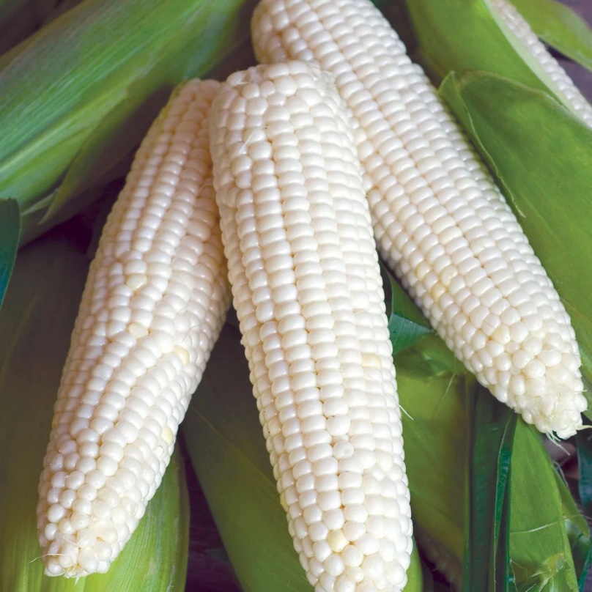
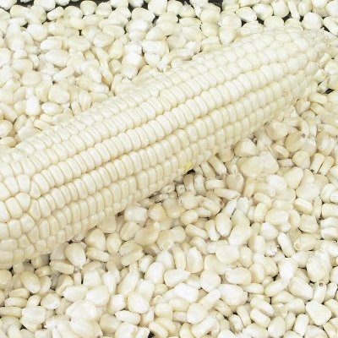
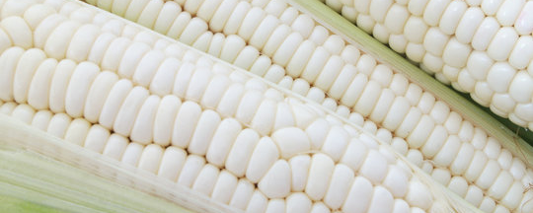
WHITE CORN
White corn is a grain crop that belongs to the Gramineae grass family. It is one of the varieties of sweet corn that is grown in different parts of the world. It is not only a grain but also considered a vegetable and a fruit. It is considered grain as it is a dry seed of a species of grass; it is a vegetable when it is harvested before maturity; it is a fruit as per botanical definition as it is the seed-bearing part of a flowering plant.
NON GMO YELLOW MAIZE CORN
Corn (maize) - one of the most popular foods in the world, and is the second best-selling grain culture after wheat, the most commonly grown type of corn is sugar yellow corn.
Yellow corn is characterized by high starch content (up to 70%) and fat (4-6%), small fiber content (2-4%).
FANTASTIC FOOD
Refine sunflower oil
High quality
Reasonable Price
Delivery on time
Many types and quality
France Aj Alimentaire

Slide 26
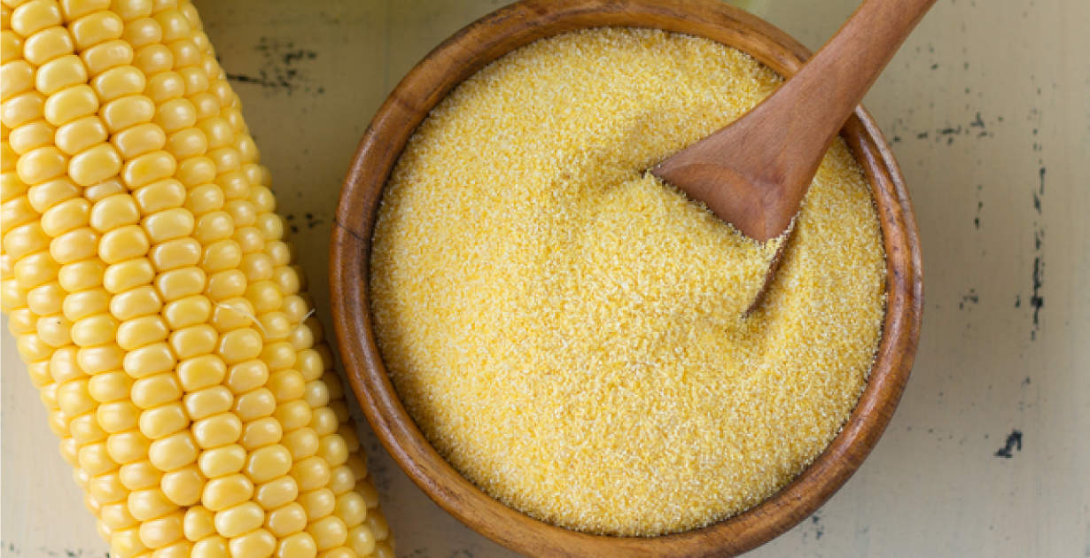
YELLOW CORN
FLOUR
Yellow Corn Flour is used as a thickening agent in liquid-based foods (e.g, soup, sauces, gravies, custard), usually by mixing it with a lower-temperature liquid to form a paste or slurry.
WHITE CORN
White corn is a grain crop that belongs to the Gramineae grass family. It is one of the varieties of sweet corn that is grown in different parts of the world. It is not only a grain but also considered a vegetable and a fruit. It is considered grain as it is a dry seed of a species of grass; it is a vegetable when it is harvested before maturity; it is a fruit as per botanical definition as it is the seed-bearing part of a flowering plant.

Slide 27
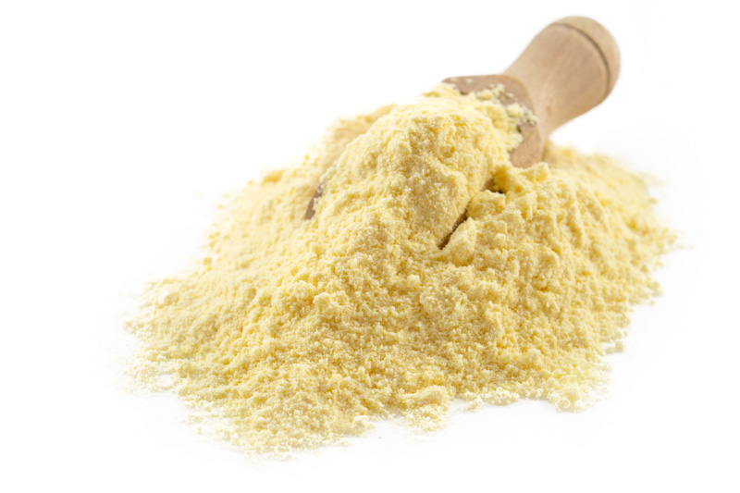
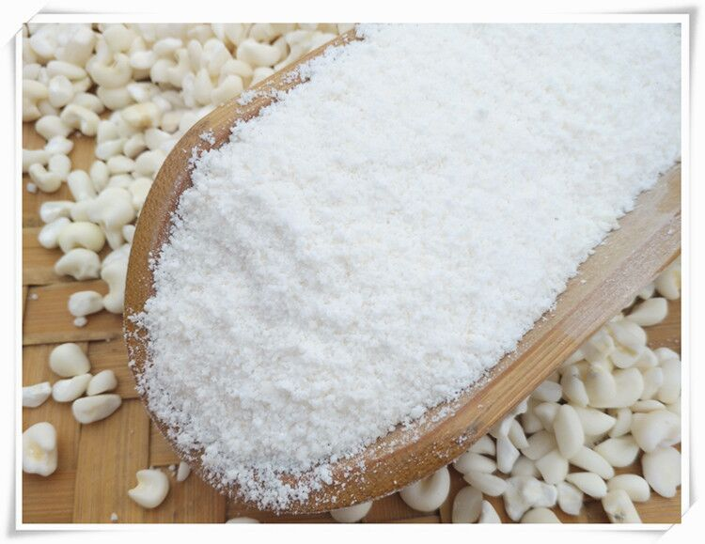
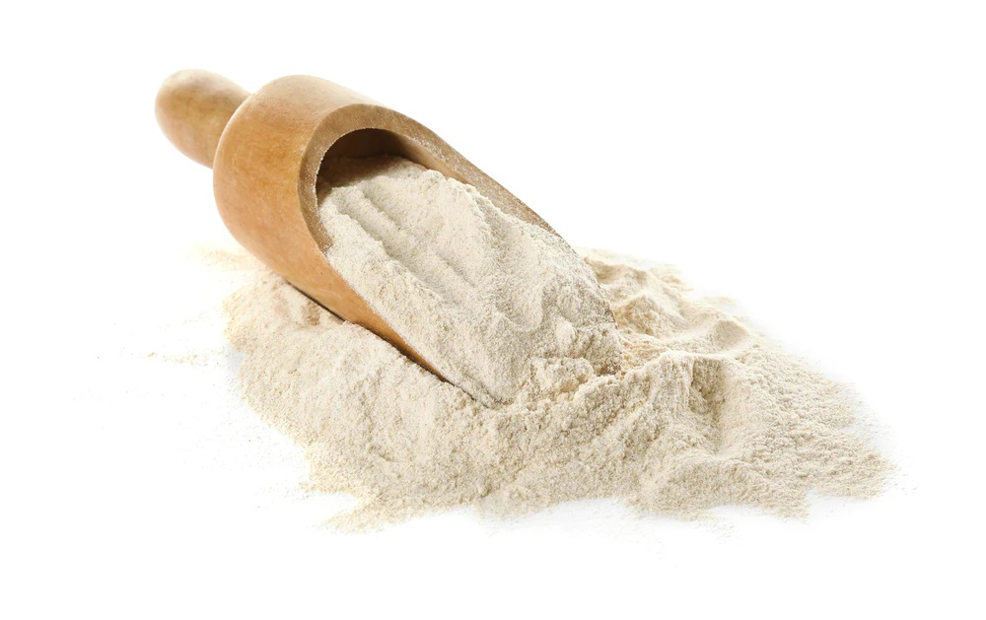
WHITE CORN
YELLOW CORN
FLOUR
White corn is a grain crop that belongs to the Gramineae grass family. It is one of the varieties of sweet corn that is grown in different parts of the world. It is not only a grain but also considered a vegetable and a fruit. It is considered grain as it is a dry seed of a species of grass; it is a vegetable when it is harvested before maturity; it is a fruit as per botanical definition as it is the seed-bearing part of a flowering plant.
Yellow Corn Flour is used as a thickening agent in liquid-based foods (e.g, soup, sauces, gravies, custard), usually by mixing it with a lower-temperature liquid to form a paste or slurry.
WHITE CORN
FLOUR
White Corn flour is Milled from dried corn kernels and is not corn meal. It is finer in texture, not gritty like cornmeal. It can be used in any recipe calling for cornmeal to produce of smoother feel to the food. White Corn flour can also substitute up to one fourth the flour in bread and baked goods for some unique taste sensations.
White Corn flour is very useful for gluten-free quick breads. Because corn flour contains no gluten, it must be blended with wheat flour when preparing yeasted breads.
An interesting substitute in baking, tortillas, muffins, pancakes and cornbread.

Slide 28
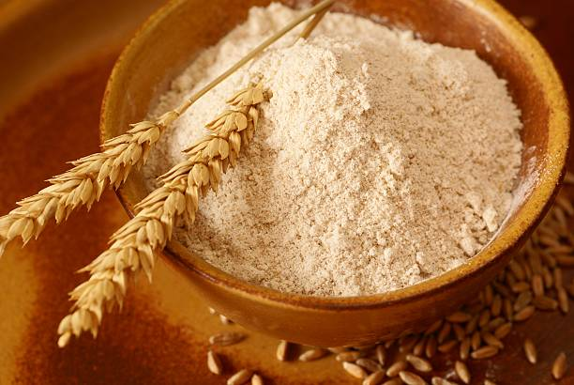
YELLOW CORN
FLOUR
WHEAT FLOUR-ALL KIND
Yellow Corn Flour is used as a thickening agent in liquid-based foods (e.g, soup, sauces, gravies, custard), usually by mixing it with a lower-temperature liquid to form a paste or slurry.
Wheat Flour is a powder made from grinding wheat, making is usable for human consumption. There are different types of wheat flour, distinguished by the amount of gluten they contain, their color, the parts of the grain used, and the type of wheat. Wheat flour is an essential ingredient in bread, cakes, cookies, and most baked goods.
WHITE CORN
FLOUR
White Corn flour is Milled from dried corn kernels and is not corn meal. It is finer in texture, not gritty like cornmeal. It can be used in any recipe calling for cornmeal to produce of smoother feel to the food. White Corn flour can also substitute up to one fourth the flour in bread and baked goods for some unique taste sensations.
White Corn flour is very useful for gluten-free quick breads. Because corn flour contains no gluten, it must be blended with wheat flour when preparing yeasted breads.
An interesting substitute in baking, tortillas, muffins, pancakes and cornbread.
France Aj Alimentaire

Slide 29
CASSAVA
FLOUR
Cassava flour is a good substitute for wheat flour in a variety of recipes. Cassava flour comes from the root vegetable cassava. This is a vegetable that is rich in carbohydrates and contains important vitamins and minerals.
France Aj Alimentaire
WHEAT FLOUR-ALL KIND
Wheat Flour is a powder made from grinding wheat, making is usable for human consumption. There are different types of wheat flour, distinguished by the amount of gluten they contain, their color, the parts of the grain used, and the type of wheat. Wheat flour is an essential ingredient in bread, cakes, cookies, and most baked goods.
France Aj Alimentaire
France Aj Alimentaire

Slide 30
CASSAVA
FLOUR
France Aj Alimentaire
Cassava flour is a good substitute for wheat flour in a variety of recipes. Cassava flour comes from the root vegetable cassava. This is a vegetable that is rich in carbohydrates and contains important vitamins and minerals.
REFINED PALM OIL
France Aj Alimentaire
WHEAT FLOUR-ALL KIND
Wheat Flour is a powder made from grinding wheat, making is usable for human consumption. There are different types of wheat flour, distinguished by the amount of gluten they contain, their color, the parts of the grain used, and the type of wheat. Wheat flour is an essential ingredient in bread, cakes, cookies, and most baked goods.
Palm oil is a very productive crop. It offers a far greater yield at a lower cost of production than other vegetable oils. Global production of and demand for palm oil is increasing rapidly. Plantations are spreading across Asia, Africa and Latin America. But such expansion comes at the expense of tropical forests—which form critical habitats for many endangered species and a lifeline for some human communities.

Slide 31
CASSAVA
FLOUR
Cassava flour is a good substitute for wheat flour in a variety of recipes. Cassava flour comes from the root vegetable cassava. This is a vegetable that is rich in carbohydrates and contains important vitamins and minerals.
France Aj Alimentaire
REFINED PALM OIL
Palm oil is a very productive crop. It offers a far greater yield at a lower cost of production than other vegetable oils. Global production of and demand for palm oil is increasing rapidly. Plantations are spreading across Asia, Africa and Latin America. But such expansion comes at the expense of tropical forests—which form critical habitats for many endangered species and a lifeline for some human communities.
France Aj Alimentaire
REFINED
GROUNDNUT OIL
France Aj Alimentaire
Peanut oil is the oil from the seed (peanut) of the peanut plant (Arachis hypogaea). Peanut oil is used in cooking and is also used to make medicine. Peanut oil is high in monounsaturated "good" Fat and low in saturated "bad" fat. This is believed to help prevent heart disease and lower cholesterol. Peanut oil might help to reduce fatty build up in blood vessels. People use peanut oil for high levels of cholesterol or other fats in the blood, heart disease, joint pain, dry skin, and many other conditions, but there is no good scientific evidence to support these uses.
France Aj Alimentaire

Slide 32
France Aj Alimentaire
REFINED PALM OIL
Palm oil is a very productive crop. It offers a far greater yield at a lower cost of production than other vegetable oils. Global production of and demand for palm oil is increasing rapidly. Plantations are spreading across Asia, Africa and Latin America. But such expansion comes at the expense of tropical forests—which form critical habitats for many endangered species and a lifeline for some human communities.
France Aj Alimentaire
France Aj Alimentaire
REFINED
GROUNDNUT OIL
Peanut oil is the oil from the seed (peanut) of the peanut plant (Arachis hypogaea). Peanut oil is used in cooking and is also used to make medicine. Peanut oil is high in monounsaturated "good" Fat and low in saturated "bad" fat. This is believed to help prevent heart disease and lower cholesterol. Peanut oil might help to reduce fatty build up in blood vessels. People use peanut oil for high levels of cholesterol or other fats in the blood, heart disease, joint pain, dry skin, and many other conditions, but there is no good scientific evidence to support these uses.
REFINED CORN OIL
France Aj Alimentaire
Corn oil is a vegetable oil valued for its pleasing, nutty flavor, relatively low levels of saturated fatty acids, high levels of linoleic acid, an essential fatty acid, and low levels of linolenic acid.
Due to its mild flavor, corn oil is popular as a cooking oil and is also used in salad dressings, shortenings, margarines, spreads, sauces and baked products.
Corn oil has a mild taste, is easily digestible, and adds nutritional value, so it is found in a variety of food and bakery products.

Slide 33
REFINED RAPESEED OIL
REFINED
GROUNDNUT OIL
Peanut oil is the oil from the seed (peanut) of the peanut plant (Arachis hypogaea). Peanut oil is used in cooking and is also used to make medicine. Peanut oil is high in monounsaturated "good" Fat and low in saturated "bad" fat. This is believed to help prevent heart disease and lower cholesterol. Peanut oil might help to reduce fatty build up in blood vessels. People use peanut oil for high levels of cholesterol or other fats in the blood, heart disease, joint pain, dry skin, and many other conditions, but there is no good scientific evidence to support these uses.
If you want a light alternative to other cooking oils, rapeseed is a great choice and has experienced a surge in popularity since around 2008. It's produced from the bright yellow rape plant that grows freely in the UK in large fields. Best cold-pressed, the oil can then be used in salad dressings, or heated to fry or bake.
It's low in saturated fat, so has been hailed for its health benefits and also has other nutritional bonuses – it contains omegas 3, 6 and 9, which reduce cholesterol and help to maintain healthy joint, brain and heart functions. As it is high in mono-unsaturated fats, it is one of the only unblended oils that can be heated to a high frying temperature and not spoil its antioxidants, character, colour or flavour. Homegrown rapeseed oil has been heralded the 'British olive oil' but its flavour is more earthy and nutty than fruity.
France Aj Alimentaire
REFINED CORN OIL
Corn oil is a vegetable oil valued for its pleasing, nutty flavor, relatively low levels of saturated fatty acids, high levels of linoleic acid, an essential fatty acid, and low levels of linolenic acid.
Due to its mild flavor, corn oil is popular as a cooking oil and is also used in salad dressings, shortenings, margarines, spreads, sauces and baked products.
Corn oil has a mild taste, is easily digestible, and adds nutritional value, so it is found in a variety of food and bakery products.
France Aj Alimentaire

Slide 34
REFINED
CANOLA OIL
Canola oil is also very high in healthier unsaturated fats. It's higher in the omega-3 fatty acid alpha-linolenic acid (ALA) than any other oil except flaxseed oil. ALA is particularly important to have in your diet because your body can't make it.
Studies show that ALA may help protect the heart through its effects on blood pressure, cholesterol, and inflammation. The FDA allows canola oil makers to label their products with a qualified health claim that there’s "limited and not conclusive" scientific evidence that switching out saturated fat for the same amount of canola oil may reduce risk of heart disease.
France Aj Alimentaire
REFINED RAPESEED OIL
If you want a light alternative to other cooking oils, rapeseed is a great choice and has experienced a surge in popularity since around 2008. It's produced from the bright yellow rape plant that grows freely in the UK in large fields. Best cold-pressed, the oil can then be used in salad dressings, or heated to fry or bake.
It's low in saturated fat, so has been hailed for its health benefits and also has other nutritional bonuses – it contains omegas 3, 6 and 9, which reduce cholesterol and help to maintain healthy joint, brain and heart functions. As it is high in mono-unsaturated fats, it is one of the only unblended oils that can be heated to a high frying temperature and not spoil its antioxidants, character, colour or flavour. Homegrown rapeseed oil has been heralded the 'British olive oil' but its flavour is more earthy and nutty than fruity.
REFINED CORN OIL
France Aj Alimentaire
Corn oil is a vegetable oil valued for its pleasing, nutty flavor, relatively low levels of saturated fatty acids, high levels of linoleic acid, an essential fatty acid, and low levels of linolenic acid.
Due to its mild flavor, corn oil is popular as a cooking oil and is also used in salad dressings, shortenings, margarines, spreads, sauces and baked products.
Corn oil has a mild taste, is easily digestible, and adds nutritional value, so it is found in a variety of food and bakery products.

Slide 35
France Aj Alimentaire
REFINED
CANOLA OIL
Canola oil is also very high in healthier unsaturated fats. It's higher in the omega-3 fatty acid alpha-linolenic acid (ALA) than any other oil except flaxseed oil. ALA is particularly important to have in your diet because your body can't make it.
Studies show that ALA may help protect the heart through its effects on blood pressure, cholesterol, and inflammation. The FDA allows canola oil makers to label their products with a qualified health claim that there’s "limited and not conclusive" scientific evidence that switching out saturated fat for the same amount of canola oil may reduce risk of heart disease.
France Aj Alimentaire
REFINED SEASAME OIL
REFINED RAPESEED OIL
The seeds come from the sesame (Sesamum indicum) plant. The seeds themselves are high in protein and B-vitamins, but sesame oil doesn’t contain the protein or many of the essential vitamins and minerals. It does, however, keep the fatty acids and antioxidants, including vitamin E and phytosterols.
Sesame oils from raw seeds are light in color and have a delicate, neutral flavor. Toasted varieties, on the other hand, are darker, richer, and have a nuttier taste. Both have many culinary applications. Sesame oil is often used to sauté meats and vegetables or is added to dressings and marinades.
Sesame oil is believed to have some important health benefits, like providing heart-healthy fats, combating inflammation, and protecting skin from sun damage. More research is needed to fully understand the benefits (and the potential risks) that sesame oil offers.
If you want a light alternative to other cooking oils, rapeseed is a great choice and has experienced a surge in popularity since around 2008. It's produced from the bright yellow rape plant that grows freely in the UK in large fields. Best cold-pressed, the oil can then be used in salad dressings, or heated to fry or bake.
It's low in saturated fat, so has been hailed for its health benefits and also has other nutritional bonuses – it contains omegas 3, 6 and 9, which reduce cholesterol and help to maintain healthy joint, brain and heart functions. As it is high in mono-unsaturated fats, it is one of the only unblended oils that can be heated to a high frying temperature and not spoil its antioxidants, character, colour or flavour. Homegrown rapeseed oil has been heralded the 'British olive oil' but its flavour is more earthy and nutty than fruity.

Slide 36
REFINED
SOYBEANS OIL
REFINED
CANOLA OIL
Canola oil is also very high in healthier unsaturated fats. It's higher in the omega-3 fatty acid alpha-linolenic acid (ALA) than any other oil except flaxseed oil. ALA is particularly important to have in your diet because your body can't make it.
Studies show that ALA may help protect the heart through its effects on blood pressure, cholesterol, and inflammation. The FDA allows canola oil makers to label their products with a qualified health claim that there’s "limited and not conclusive" scientific evidence that switching out saturated fat for the same amount of canola oil may reduce risk of heart disease.
This is a vegetable oil derived from soybean seeds. The oil can be obtained in two different ways: pressing and extracting. Soybean oil is particularly rich in essential fatty acids.
Soybean oil is a valuable ingredient in cosmetics. It supports cell renewal and protects the skin cells, preventing signs of aging. Soybean Oil is a good moisturizer as well, leaving the skin smooth and supple.
REFINED SEASAME OIL
France Aj Alimentaire
The seeds come from the sesame (Sesamum indicum) plant. The seeds themselves are high in protein and B-vitamins, but sesame oil doesn’t contain the protein or many of the essential vitamins and minerals. It does, however, keep the fatty acids and antioxidants, including vitamin E and phytosterols.
Sesame oils from raw seeds are light in color and have a delicate, neutral flavor. Toasted varieties, on the other hand, are darker, richer, and have a nuttier taste. Both have many culinary applications. Sesame oil is often used to sauté meats and vegetables or is added to dressings and marinades.
Sesame oil is believed to have some important health benefits, like providing heart-healthy fats, combating inflammation, and protecting skin from sun damage. More research is needed to fully understand the benefits (and the potential risks) that sesame oil offers.
France Aj Alimentaire

Slide 37
Sunflower Oil
Refine sunflower oil
High quality
Reasonable Price
Delivery on time
Many types and quality
REFINED
SOYBEANS OIL
This is a vegetable oil derived from soybean seeds. The oil can be obtained in two different ways: pressing and extracting. Soybean oil is particularly rich in essential fatty acids.
Soybean oil is a valuable ingredient in cosmetics. It supports cell renewal and protects the skin cells, preventing signs of aging. Soybean Oil is a good moisturizer as well, leaving the skin smooth and supple.
REFINED SEASAME OIL
France Aj Alimentaire
The seeds come from the sesame (Sesamum indicum) plant. The seeds themselves are high in protein and B-vitamins, but sesame oil doesn’t contain the protein or many of the essential vitamins and minerals. It does, however, keep the fatty acids and antioxidants, including vitamin E and phytosterols.
Sesame oils from raw seeds are light in color and have a delicate, neutral flavor. Toasted varieties, on the other hand, are darker, richer, and have a nuttier taste. Both have many culinary applications. Sesame oil is often used to sauté meats and vegetables or is added to dressings and marinades.
Sesame oil is believed to have some important health benefits, like providing heart-healthy fats, combating inflammation, and protecting skin from sun damage. More research is needed to fully understand the benefits (and the potential risks) that sesame oil offers.
France Aj Alimentaire

Slide 38
France Aj Alimentaire
YELLOW CORN
FLOUR
Sunflower Oil
Refine sunflower oil
High quality
Reasonable Price
Delivery on time
Many types and quality
France Aj Alimentaire
VEGETABLE COOKING
OI
REFINED
SOYBEANS OIL
RBD Palm Olein is the liquid fraction obtained by the fractionation of palm oil after crystallization at controlled temperatures. It is especially suitable for frying and cooking. Main applications of RBD Palm Olein include salad and cooking oils in households, industrial frying fat of instant noodles, potato chips, doughnuts and condensed milk.
This is a vegetable oil derived from soybean seeds. The oil can be obtained in two different ways: pressing and extracting. Soybean oil is particularly rich in essential fatty acids.
Soybean oil is a valuable ingredient in cosmetics. It supports cell renewal and protects the skin cells, preventing signs of aging. Soybean Oil is a good moisturizer as well, leaving the skin smooth and supple.
France Aj Alimentaire

Slide 39
Sunflower Oil
Refine sunflower oil
High quality
Reasonable Price
Delivery on time
Many types and quality
VEGETABLE COOKING
OIL
RBD Palm Olein is the liquid fraction obtained by the fractionation of palm oil after crystallization at controlled temperatures. It is especially suitable for frying and cooking. Main applications of RBD Palm Olein include salad and cooking oils in households, industrial frying fat of instant noodles, potato chips, doughnuts and condensed milk.
France Aj Alimentaire
4011AAA
GREEN TEA
Profile of the tea to the fullest extent. All our ingredients are 100 % Natural.
No dust, no fanning: our teas are processed in a manner that minimizes drying - consequently, our teas ensure that the flavor
Components like tannins and essential oils are retained to the maximum extent giving you a more flavorsome experience.
Morning Boost – Jumpstart your Morning With Extra Energy
FRESH ORTHODOX LOOSE LEAF TEA WITH 100% NATURAL INGREDIENTS: Chunli's Green teas contain loose leaves that retain the flavour

Slide 40
CHINA GREEN TEA
GUNPOWDER 3505
VEGETABLE COOKING
OIL
RBD Palm Olein is the liquid fraction obtained by the fractionation of palm oil after crystallization at controlled temperatures. It is especially suitable for frying and cooking. Main applications of RBD Palm Olein include salad and cooking oils in households, industrial frying fat of instant noodles, potato chips, doughnuts and condensed milk.
France Aj Alimentaire
Profile of the tea to the fullest extent. All our ingredients are 100 % Natural.
No dust, no fanning: our teas are processed in a manner that minimizes drying - consequently, our teas ensure that the flavor
Components like tannins and essential oils are retained to the maximum extent giving you a more flavorsome experience.
4011AAA
GREEN TEA
Morning Boost – Jumpstart your Morning With Extra Energy
FRESH ORTHODOX LOOSE LEAF TEA WITH 100% NATURAL INGREDIENTS: Chunli's Green teas contain loose leaves that retain the flavour

Slide 41
KAMPOT PEPPER
Harvested when still young on the vine, Kampot green pepper aromas literally explode on the palate with a very mild pepperiness. This fresh pepper accommodates perfectly a grilled squid dish. This fresh pepper is a perfect match for a fried squid dish
Kampot black pepper delivers a strong and delicate aroma. Its taste, which can range from intensely spicy to mildly sweet, reveals hints of flower, eucalyptus and mint. This black pepper suits all kind of dishes and distinguishes itself in particular with grilled fish.
Kampot peppers’ specificities come from the mildness of their spice, the freshness and complexity of their aromas and their exceptional lingering taste.
This disconcerting pepper allows for the wildest combinations, from wild meat seasoning to vanilla desserts.
Harvested when the berry is fully mature on the vine, Kampot red pepper delivers a powerful and fruity aroma. Its taste combines the spicy, mature flavor of black pepper with a sugary sweetness.
Kampot red and white peppers are extremely rare due to the difficulty in harvesting fully mature pepper. Only a few hundreds of kilos are produced each year.
Obtained by soaking the red berries in water for a few days, Kampot white pepper develops an intense bouquet and delicate aroma. Its strong spicy taste carries notes of fresh grass and lime.
Hardwood Charcoal is an important product obtained from wood. Hardwood Charcoal is used widely as domestic and industrial fuel. Hardwood Charcoal is also used to produce activated carbon. Activated Carbon produced from wood has certain specific advantages as the raw material can adsorb certain molecular species.
CHINA GREEN TEA
GUNPOWDER 3505
France Aj Alimentaire
Profile of the tea to the fullest extent. All our ingredients are 100 % Natural.
No dust, no fanning: our teas are processed in a manner that minimizes drying - consequently, our teas ensure that the flavor
Components like tannins and essential oils are retained to the maximum extent giving you a more flavorsome experience.
4011AAA
GREEN TEA
Morning Boost – Jumpstart your Morning With Extra Energy
FRESH ORTHODOX LOOSE LEAF TEA WITH 100% NATURAL INGREDIENTS: Chunli's Green teas contain loose leaves that retain the flavour

Slide 42
France Aj Alimentaire
KAMPOT PEPPER
Harvested when still young on the vine, Kampot green pepper aromas literally explode on the palate with a very mild pepperiness. This fresh pepper accommodates perfectly a grilled squid dish. This fresh pepper is a perfect match for a fried squid dish
Kampot black pepper delivers a strong and delicate aroma. Its taste, which can range from intensely spicy to mildly sweet, reveals hints of flower, eucalyptus and mint. This black pepper suits all kind of dishes and distinguishes itself in particular with grilled fish.
Kampot peppers’ specificities come from the mildness of their spice, the freshness and complexity of their aromas and their exceptional lingering taste.
This disconcerting pepper allows for the wildest combinations, from wild meat seasoning to vanilla desserts.
Harvested when the berry is fully mature on the vine, Kampot red pepper delivers a powerful and fruity aroma. Its taste combines the spicy, mature flavor of black pepper with a sugary sweetness.
Kampot red and white peppers are extremely rare due to the difficulty in harvesting fully mature pepper. Only a few hundreds of kilos are produced each year.
Obtained by soaking the red berries in water for a few days, Kampot white pepper develops an intense bouquet and delicate aroma. Its strong spicy taste carries notes of fresh grass and lime.
HONEY
Honey is a sweet fluid made by honeybees using the nectar of flowering plants. There are about 320 different varieties of honey, which vary in color, odor and flavor.
Honey contains mostly sugar, as well as a mix of amino acids, vitamins, minerals, iron, zinc and antioxidants. In addition to its use as a natural sweetener, honey is used as an anti-inflammatory, antioxidant and antibacterial agent. People commonly use honey orally to treat coughs and topically to treat burns and promote wound healing.
Profile of the tea to the fullest extent. All our ingredients are 100 % Natural.
No dust, no fanning: our teas are processed in a manner that minimizes drying - consequently, our teas ensure that the flavor
Components like tannins and essential oils are retained to the maximum extent giving you a more flavorsome experience.
CHINA GREEN TEA
GUNPOWDER 3505
France Aj Alimentaire
We are trading and manufacturer of all kind of copier paper worldwide. Paper size A4 (210 X 297 mm.) Whiteness: A grade (102-104%) Weight: 70 gsm, 75 gsm, 80 gsm available! Paper from Farmed Trees Double-A High-quality paper renown for its excellent performance and environmental friendly attributes is suitable for photocopies, printing with inkjet and laser printers and offset preprints. Double-A Color Paper 80 gsm. A4 (210 X 297 mm.) Paper, Premium quality for your printing and copying

Slide 43
CHARCOAL
Hardwood Charcoal is an important product obtained from wood. Hardwood Charcoal is used widely as domestic and industrial fuel. Hardwood Charcoal is also used to produce activated carbon. Activated Carbon produced from wood has certain specific advantages as the raw material can adsorb certain molecular species.
France Aj Alimentaire
KAMPOT PEPPER
HONEY
Honey is a sweet fluid made by honeybees using the nectar of flowering plants. There are about 320 different varieties of honey, which vary in color, odor and flavor.
Honey contains mostly sugar, as well as a mix of amino acids, vitamins, minerals, iron, zinc and antioxidants. In addition to its use as a natural sweetener, honey is used as an anti-inflammatory, antioxidant and antibacterial agent. People commonly use honey orally to treat coughs and topically to treat burns and promote wound healing.

Slide 44
COPY
PAPER A4
France Aj Alimentaire
CHARCOAL
Hardwood Charcoal is an important product obtained from wood. Hardwood Charcoal is used widely as domestic and industrial fuel. Hardwood Charcoal is also used to produce activated carbon. Activated Carbon produced from wood has certain specific advantages as the raw material can adsorb certain molecular species.
HONEY
Honey is a sweet fluid made by honeybees using the nectar of flowering plants. There are about 320 different varieties of honey, which vary in color, odor and flavor.
Honey contains mostly sugar, as well as a mix of amino acids, vitamins, minerals, iron, zinc and antioxidants. In addition to its use as a natural sweetener, honey is used as an anti-inflammatory, antioxidant and antibacterial agent. People commonly use honey orally to treat coughs and topically to treat burns and promote wound healing.

Slide 45
SUGARCAN
BAGASSE PELLETS
Sugarcane is a tree-free renewable resource, which makes it superior to other kind of fuels. Sugarcane bagasse pellets are with high calorific value of 3400 to 4200 kilocalorie and low ash. It’s a wise choice as fuel energy.
France Aj Alimentaire
COPY
PAPER A4
The char yield of the larger pellets of high-ash content bagasse was practically independent of treatment conditions. Smaller pellets gave better mechanical stability of the char but lower reactivity.
Palletization facilitates utilization of sugar cane bagasse as a fuel and storage for year-round electricity generation.
CHARCOAL
We are trading and manufacturer of all kind of copier paper worldwide. Paper size A4 (210 X 297 mm.) Whiteness: A grade (102-104%) Weight: 70 gsm, 75 gsm, 80 gsm available! Paper from Farmed Trees Double-A High-quality paper renown for its excellent performance and environmental friendly attributes is suitable for photocopies, printing with inkjet and laser printers and offset preprints. Double-A Color Paper 80 gsm. A4 (210 X 297 mm.) Paper, Premium quality for your printing and copying
France Aj Alimentaire
Hardwood Charcoal is an important product obtained from wood. Hardwood Charcoal is used widely as domestic and industrial fuel. Hardwood Charcoal is also used to produce activated carbon. Activated Carbon produced from wood has certain specific advantages as the raw material can adsorb certain molecular species.
The present work determines thermochemical characteristics of bagasse pellets of different sizes and origins, using various temperatures and gas flow rates with varying concentrations of oxygen in mixtures with nitrogen.
Of major interest are the effects of raw material, origin and size of pellets, and the treatment conditions on the rate of pyrolysis and the structure and reactivity of char in combustion.

Slide 46
WOOD SHAVING &
WOOD CHIPS
SUGARCAN
BAGASSE PELLETS
The char yield of the larger pellets of high-ash content bagasse was practically independent of treatment conditions. Smaller pellets gave better mechanical stability of the char but lower reactivity.
Sugarcane is a tree-free renewable resource, which makes it superior to other kind of fuels. Sugarcane bagasse pellets are with high calorific value of 3400 to 4200 kilocalorie and low ash. It’s a wise choice as fuel energy.
USED AS WOOD SHAVINGS
Wood Shavings/ Wood Sawdust provide users with undeniable benefits such as low cost, high heat production, safe use without causing environmental pollution. Wood Shavings/ Wood Sawdust pellets are widely used for large-scale operations such as industrial production and agricultural operations. Used as a fuel for industrial and civil use, used in pasteurizing, sterilizing in food factories, used in industrial liquor systems, In the farms, drying timber, animal feed, warm water in the pool at the swimming pool, restaurants ..
Palletization facilitates utilization of sugar cane bagasse as a fuel and storage for year-round electricity generation.
Of major interest are the effects of raw material, origin and size of pellets, and the treatment conditions on the rate of pyrolysis and the structure and reactivity of char in combustion.
The present work determines thermochemical characteristics of bagasse pellets of different sizes and origins, using various temperatures and gas flow rates with varying concentrations of oxygen in mixtures with nitrogen.
France Aj Alimentaire

Slide 47
France Aj Alimentaire
WOOD SHAVING &
WOOD CHIPS
OUR CERTIFICATIONS
USED AS WOOD SHAVINGS
Wood Shavings/ Wood Sawdust provide users with undeniable benefits such as low cost, high heat production, safe use without causing environmental pollution. Wood Shavings/ Wood Sawdust pellets are widely used for large-scale operations such as industrial production and agricultural operations. Used as a fuel for industrial and civil use, used in pasteurizing, sterilizing in food factories, used in industrial liquor systems, In the farms, drying timber, animal feed, warm water in the pool at the swimming pool, restaurants ..
9001
22000

Slide 48
CONTACT US
OUR CERTIFICATIONS
23 Samdach Pan Ave (214), Sangkat Boeng
Reang, Khan Duan Penh Phnom Penh,Cambodia
Franceajalimentaire@gmail.com
+(855) 17 909 642
+(855) 16 909 642
www.franceajalimentaire.com
www.franceajfood.com
9001
22000

Slide 49
CONTACT US
OUR CERTIFICATIONS
23 Samdach Pan Ave (214), Sangkat Boeng
Reang, Khan Duan Penh Phnom Penh,Cambodia
Franceajalimentaire@gmail.com
+(855) 17 909 642
+(855) 16 909 642
www.franceajalimentaire.com
www.franceajfood.com
9001
22000

